Slide 1



GENDER AND TRANSITIONAL JUSTICE: CRIMINAL JUSTICE
Funded by the European Union
Notes:
This presentation was produced as part of the series, Gender and Transitional Justice: A Training Module Series by the International Center for Transitional Justice (ICTJ). These modules were produced with the financial support of the European Union. Their contents are the sole responsibility of ICTJ and do not necessarily reflect the views of UN Women and the European Union. October 2018.

Slide 2
Introduction
Sexual and gender-based violence (SGBV) is universally prevalent in times of conflict or authoritarianism.
Historically, rape and other forms of SGBV were considered inevitable — and un-prosecutable — consequences of armed conflict.
Thanks to decades of struggle by activists, today, SGBV is generally recognized as a weapon of war.
SGBV and can be prosecuted as an international crime, such as war crimes, crimes against humanity, and genocide.
© ICTJ 2018

Slide 3
What Is Sexual and Gender-based Violence?
Sexual violence is “any sexual act, attempt to obtain a sexual act, unwanted sexual comments or advances, or act to traffic, or otherwise directed at a person’s sexuality using coercion, by any person regardless of their relationship to the victim, in any setting, including but not limited to home and work.” — World Health Organization
Gender-based violence occurs when someone is targeted because of their gender.
Sexual violence is always a form of gender-based violence. But not all gender-based violations are sexual violence.
© ICTJ 2018

Slide 4
Examples of SGBV
Rape
Sexual slavery
Enforced prostitution
Forced marriage
Forced pregnancy
Forced abortion
Enforced sterilization
Castration
Genital torture
Forced nudity
© ICTJ 2018

Slide 5
2. Why Prosecutions?
Re-establish the rule of law
Recognize the criminality of acts of harm
End impunity for such harms
Deter perpetrators by warning them that they will be punished
© ICTJ 2018

Slide 6
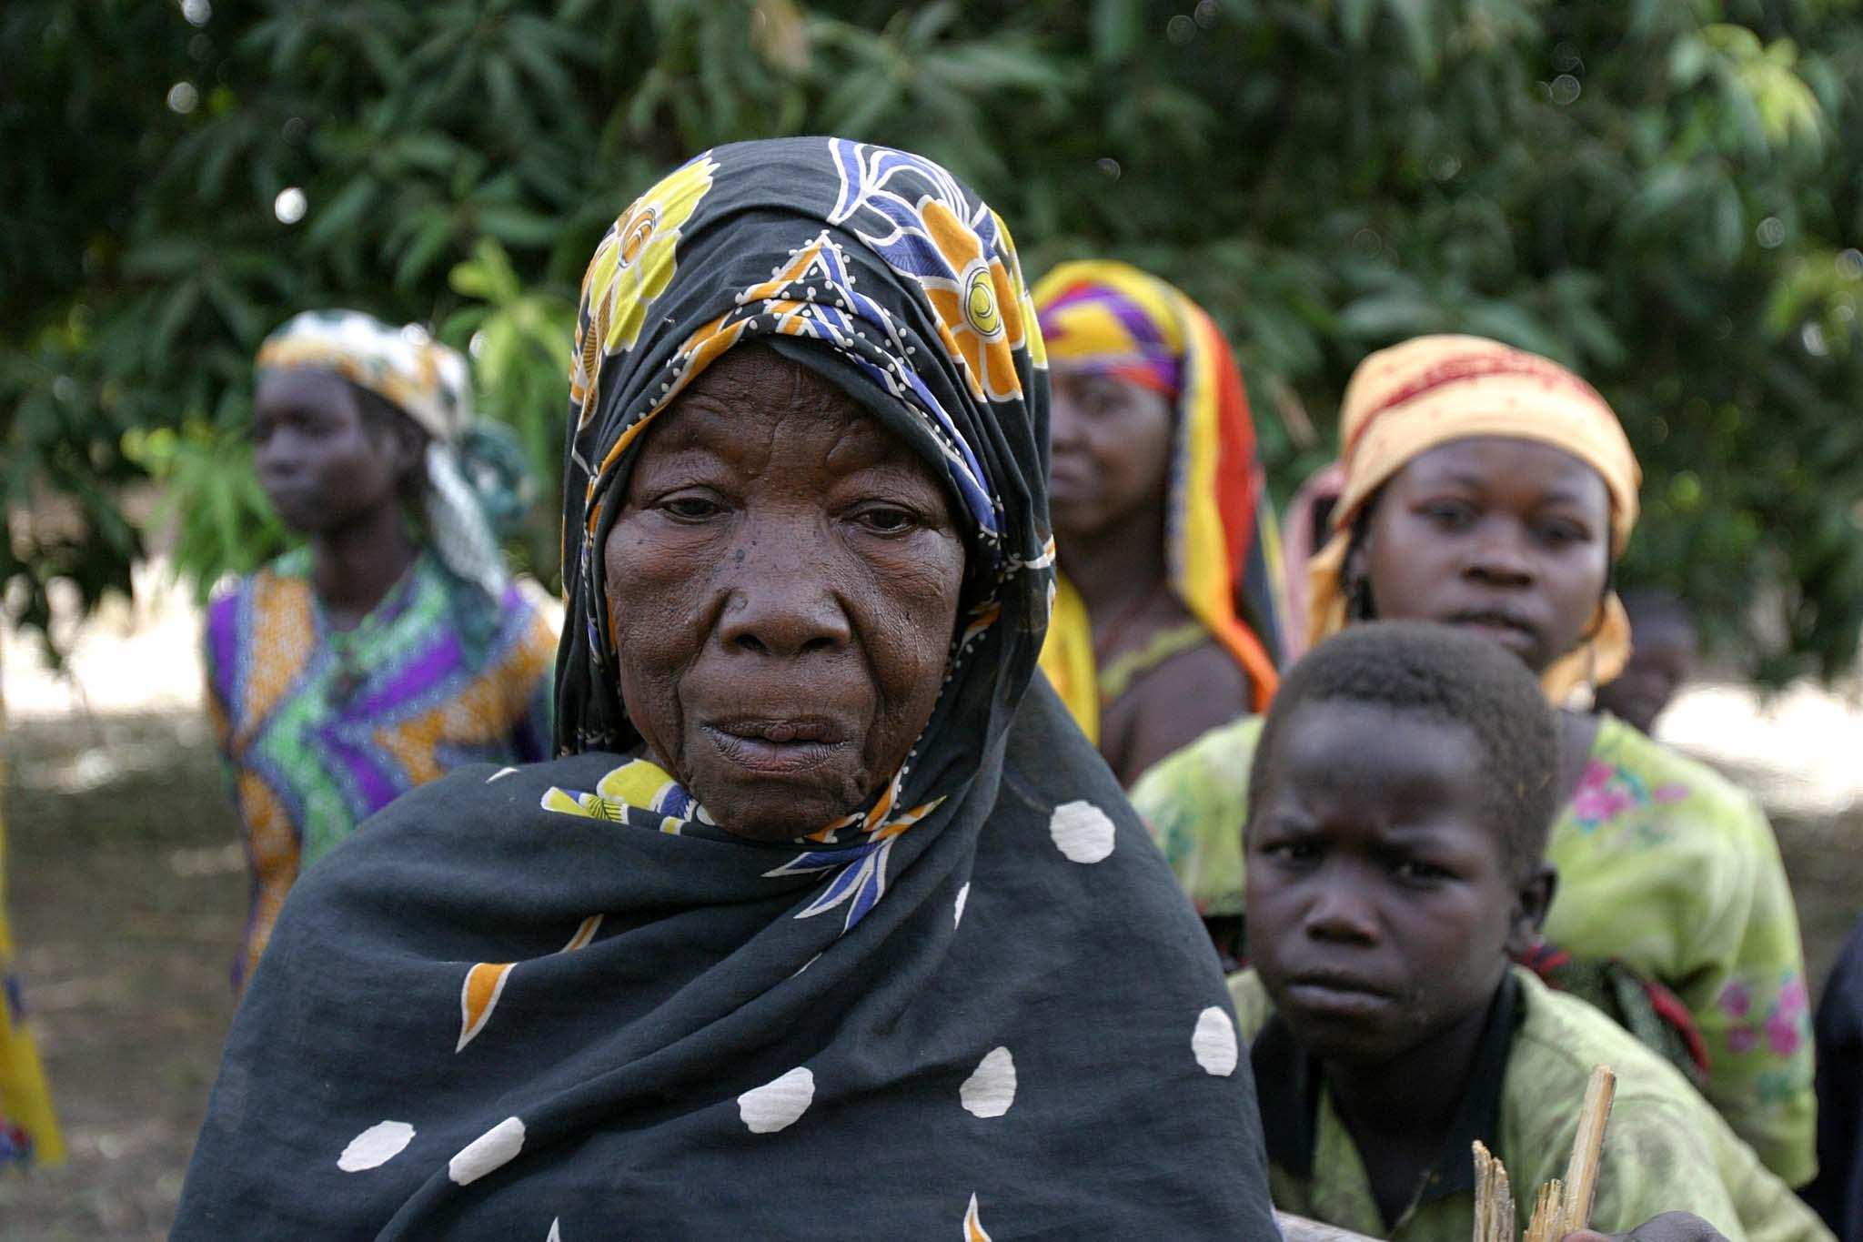
Need for a Proactive Approach on Gender
A proactive, gender-sensitive approach entails:
focusing on gender in terms of how investigations are carried out and charges are formulated;
focusing on both individual acts of SGBV and systemic conditions that enable such abuses;
ensuring equal access to justice, including for women victims and all victims of SGBV.
© ICTJ 2018
Notes:
Photo: A woman and her conflict-affected family in the village of Kéché, in the rebel-led zone, northeastern Central African Republic. (UNICEF/Pierre Holtz)

Slide 7
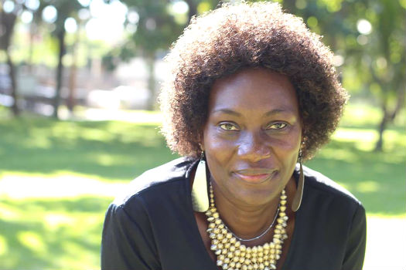
Advancing Gender Justice
In the long-term, prosecutions of SGBV can:
establish women as more powerful players with effective rights;
highlight the need to enhance women’s access to justice;
establish legal precedent for reforming domestic penal codes, including on peacetime SGBV;
contribute to breaking cycles of impunity;
send a warning to perpetrators that they will be punished.
© ICTJ 2018
Notes:
Photo: Jacqueline Mutere was raped during the post-election violence and is now the leader of the women’s organization Grace Agenda. (ICTJ/Sam McCann)

Slide 8
3. Prosecuting SGBV under International Law
SGBV as an International Crime
Acts of SGBV can be prosecuted as war crimes, crimes against humanity, or genocide.
Modes of Liability for International Crimes
There are two modes of responsibility for international crimes: direct responsibility and command or superior responsibility.
© ICTJ 2018

Slide 9
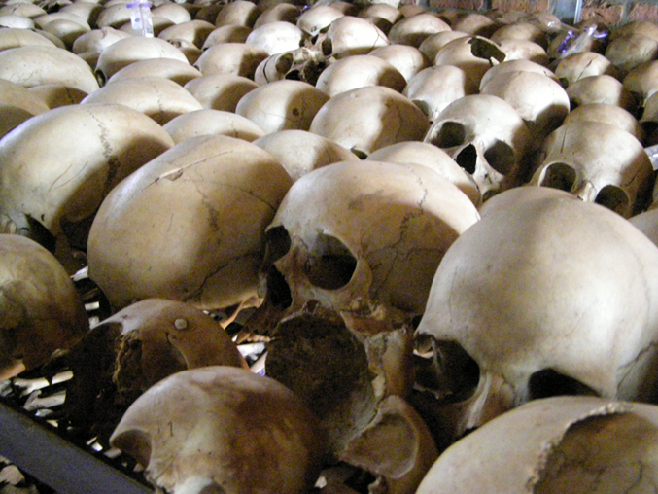
A commander or superior may be liable for their subordinates’ crimes via command or superior responsibility if:
they had effective command and control over their subordinates;
they knew or should have known their subordinates were committing or about to commit crimes;
they failed to take all necessary measures to prevent or repress the commission of crimes or to investigate and prosecute the directly responsible subordinates; and
their failure to exercise control properly over subordinates resulted in the commission of the crimes.
© ICTJ 2018
Notes:
Photo: Rwanda Genocide Memorial (Configmanager/Twitter)

Slide 10
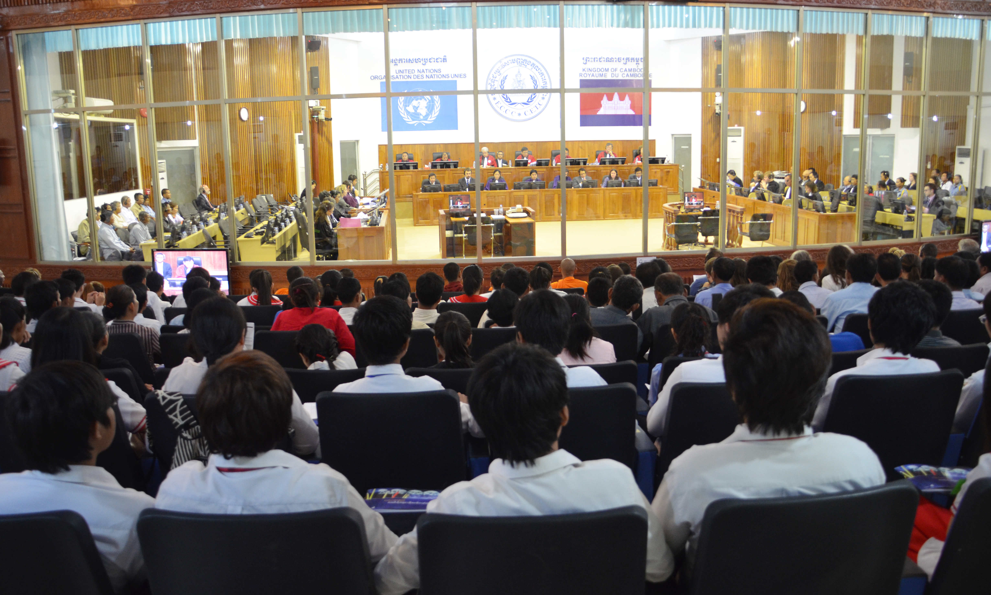
4. Mechanisms for Pursuing Accountability for SGBV in Transitional Contexts
International or regional prosecutions
Domestic or national-level prosecutions
Hybrid prosecutions
© ICTJ 2018
Notes:
Photo: Preliminary hearing at the Extraordinary Chambers in the Courts of Cambodia. (Wikimedia Commons/ECCC)

Slide 11
Complementarity
In accordance with the principle of complementarity, regional and international courts will only prosecute international crimes if the national authorities are unable or unwilling to prosecute domestically.
“Positive complementarity” refers to the ability of international courts to pressure national authorities to take steps toward domestic prosecutions.
© ICTJ 2018

Slide 12
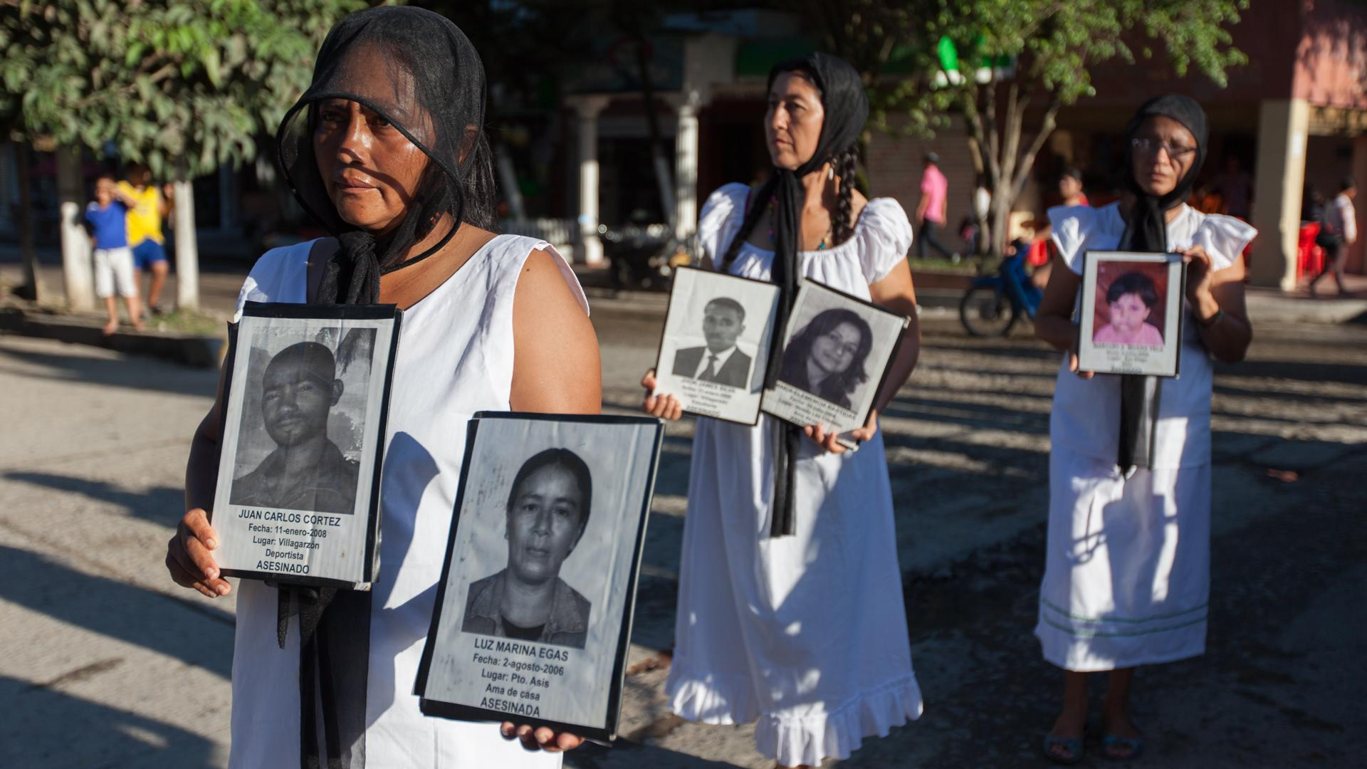
Colombia
Notes:
Photo: Members of Ruta Pacífica de las Mujeres demonstrate to bring attention to how the conflict has affected women. (ICTJ/Camilo Aldana Sanín)

Slide 13
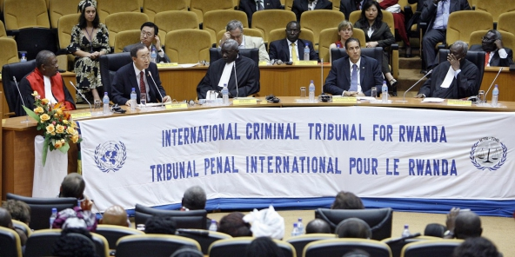
Examples of International Mechanisms
Ad Hoc International Tribunals
International Criminal Tribunal for the former Yugoslavia (ICTY) (1993–2017)
International Criminal Tribunal for Rwanda (ICTR) (1994–2015)
International Residual Mechanism for Criminal Tribunals (2010–present)
Permanent International Court
International Criminal Court (ICC) (2002–present)
© ICTJ 2018
Notes:
Photo: The UN Secretary General addresses ICTR staff in 2009. (UN Photo)

Slide 14
Examples of Regional Mechanisms
Africa: African Court on Human and Peoples’ Rights; African Commission on Human and Peoples’ Rights
Americas: Inter-American Court of Human Rights; Inter-American Commission on Human Rights
Europe: European Court of Human Rights; European Committee of Social Rights
Middle East: Arab Human Rights Committee
Southeast Asia: Association of Southeast Asian Nations (ASEAN) Intergovernmental Commission on Human Rights
© ICTJ 2018

Slide 15
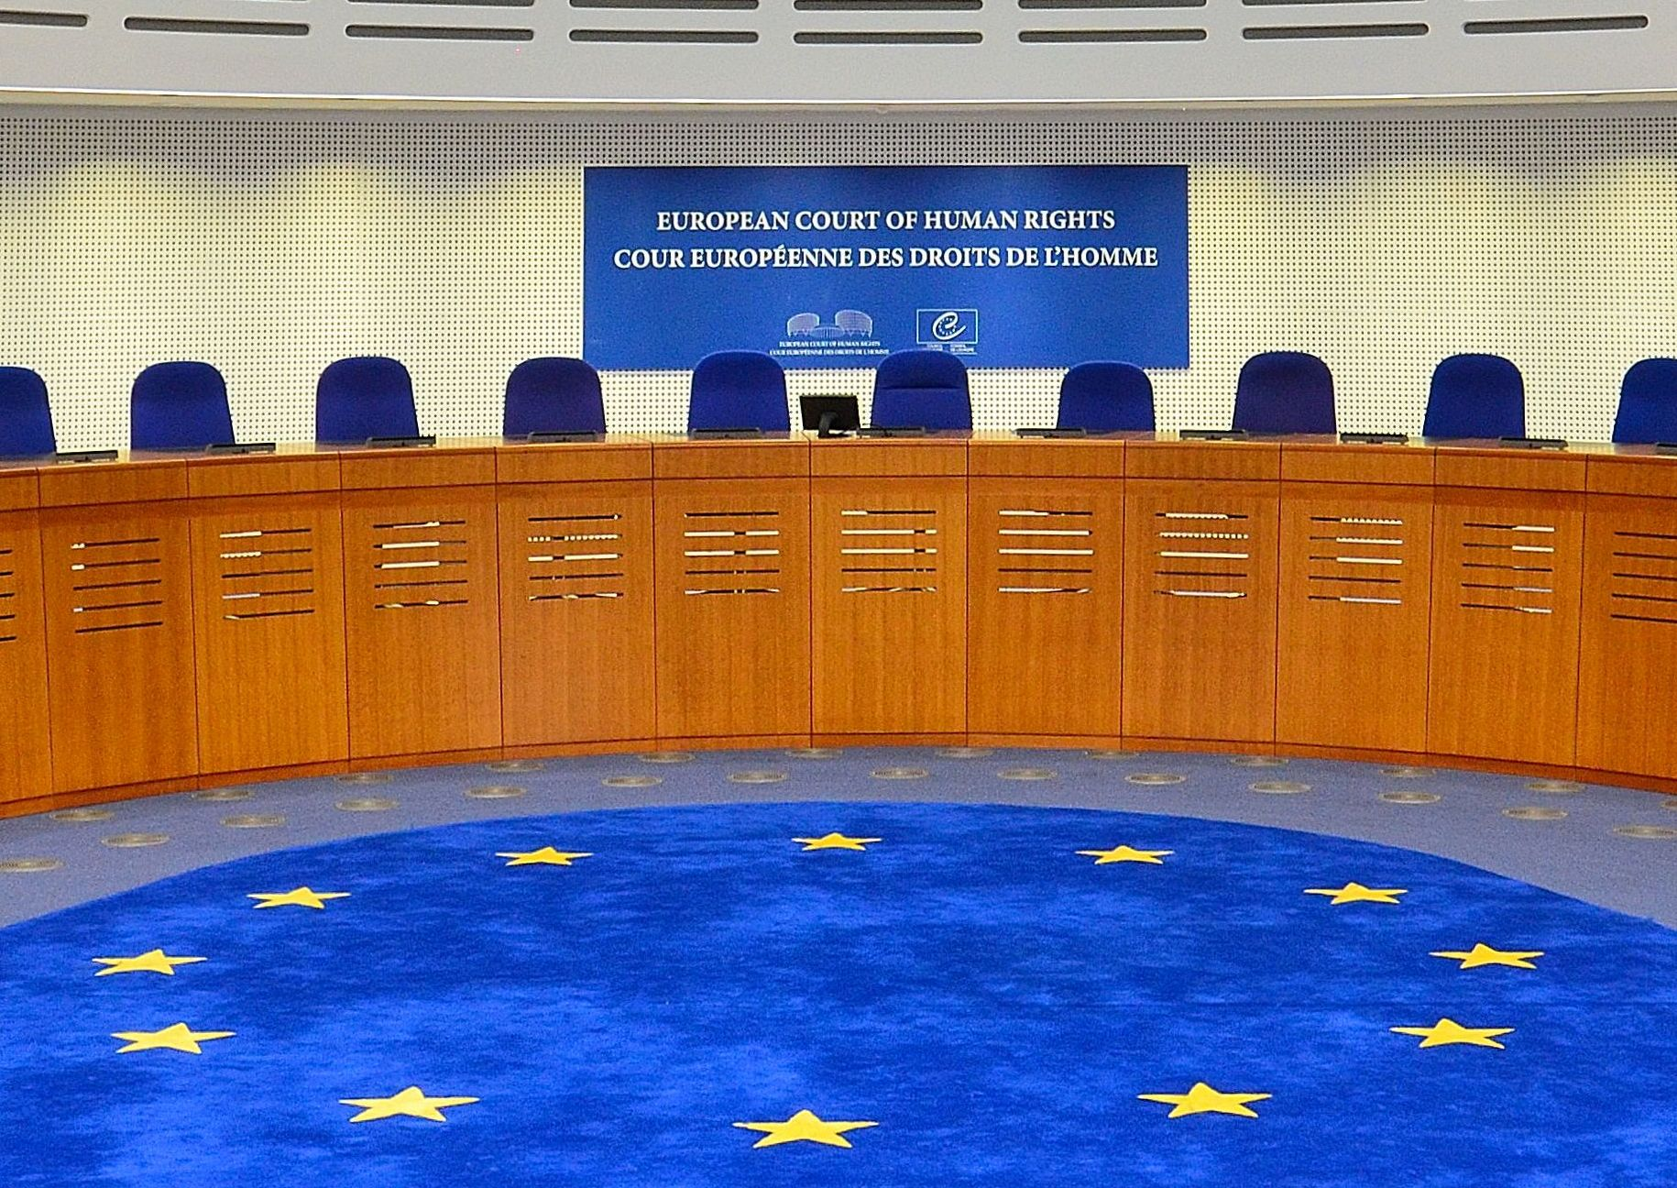
European Court of Human Rights
© ICTJ 2018
Notes:
Photo: The courtroom of the European Court of Human Rights. (Wikimedia Commons/Adrian Grycuk)

Slide 16
Advantages of National Prosecutions
Provide increased visibility and access to victims, witnesses, and evidence as well as local language staff, lawyers, judges, and materials
Allow the state to demonstrate its willingness to pursue prosecutions
Rebuild trust in state institutions
More economically and resource efficient
© ICTJ 2018

Slide 17
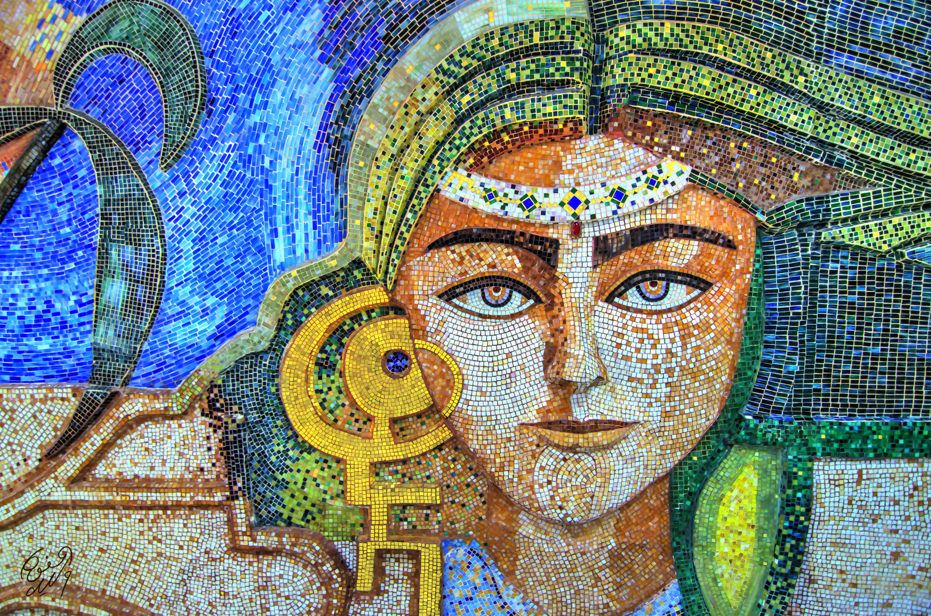
Tunisia
Notes:
Photo: Mosaic of a woman in Tunisia. (Flickr/Walid Mahfoudh)

Slide 18
Disadvantages of National Prosecutions
Greater potential for bias
Restrictive national-level definitions of crimes, especially SGBV
Inadequate legal and judicial infrastructure
Inadequate experience prosecuting international crimes
© ICTJ 2018

Slide 19
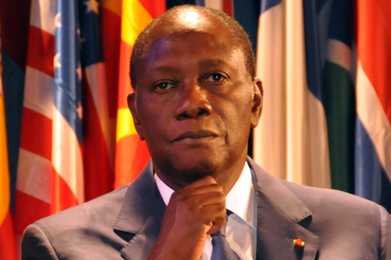
Côte d’Ivoire
Notes:
Photo: Côte d’Ivoire President Alassane Ouattara. (Hugo Passarello Luna)

Slide 20
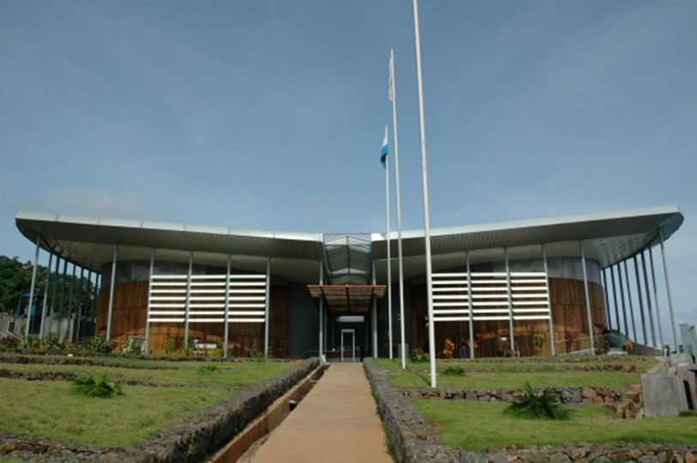
Hybrid courts, or mixed tribunals, combine national and international elements to best suit the context in which they operate.
© ICTJ 2018
Notes:
Photo: Building of the Special Court for Sierra Leone in Freetown. (SCSL Photo Archive)

Slide 21
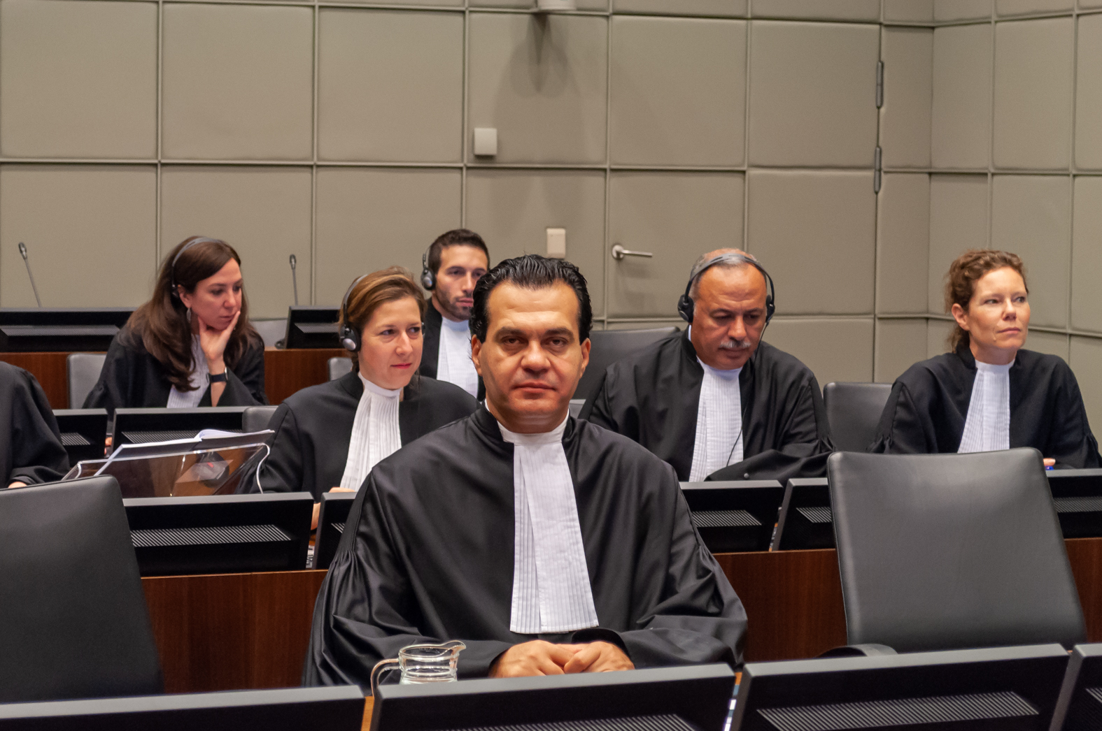
Advantages of Hybrid Prosecutions
Help build capacity of local judicial systems and expertise in prosecuting international crimes
Provide more visibility and access to affected society than international trials
Ability to balance various domestic and international elements, such as staff, substantive and procedural law, jurisdiction, and funding
© ICTJ 2018
Notes:
The Ayyash Courtroom of the Special Tribunal for Lebanon. (Flickr)

Slide 22
Disadvantages of Hybrid Prosecutions
Hybrid prosecutions can struggle with:
ensuring national- and international-level political will;
carrying out a proper recruitment of experienced international staff;
promoting an adequate relationship between national and international staff;
guaranteeing coherent planning and resourcing;
lack of enforcement powers.
© ICTJ 2018

Slide 23
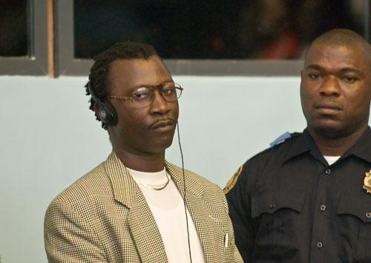
Examples of Hybrid Mechanisms
Bosnian War Crimes Chamber
Extraordinary African Chambers
Extraordinary Chambers in the Courts of Cambodia (ECCC)
Kosovo Specialist Chambers
Serious Crimes Process in Timor-Leste
Special Criminal Court in Central African Republic
Special Court for Sierra Leone (SCSL)
Special Tribunal for Lebanon
© ICTJ 2018
Notes:
Photo: Alex Tamba Brima, also known as “Gullit” after a Dutch football star. (SCSL Photo Archive)

Slide 24
Emblematic Hybrid Courts
Bosnia War Crimes Chamber
Extraordinary African Chambers
ECCC
SCSL
From hybrid to domestic court
The Bosnia War Crimes Chamber eventually phased out its international staff and became a purely nationally run court.
Mixed tribunal under national law that was promulgated in accordance with a treaty
The ECCC is an independent Cambodian court with international participation that applies international standards.
World’s first hybrid international criminal tribunal
The SCSL took many laudable steps toward ensuring a gender-sensitive process, many of which are highlighted in examples throughout the remainder of this module.
Hybrid court using universal jurisdiction
The court is the first universal jurisdiction trial in Africa and the first trial of a former head of state of one country to take place in another country.

Slide 25
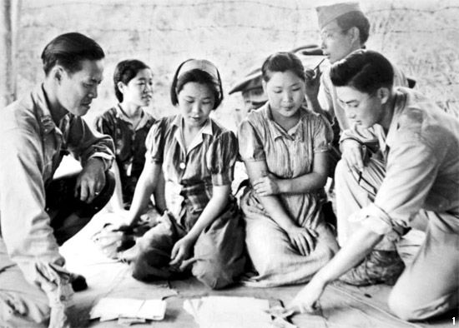
5. Evolution of Prosecuting SGBV
Post-World War II trials largely neglected SGBV crimes.
  35 Dutch “comfort women” got justice while 200,000 Asian “comfort women” did not, illustrating how intersectionality can impact access to justice
In the 1990s, the ICTR and ICTY made key rulings on gender, all thanks to gender representation in the courts and activism by women’s groups.
© ICTJ 2018
Notes:
Photo: Three Korean “comfort girls” (captured in Burma) are interrogated by Capt. Won Loy Chan (San Francisco, California), Tech. Sgt. Robert Honda (Hawaii), and Sgt. Hirabayashi (Seattle, Washington), all of the G-2 Myitkyina Task Force of the U.S. Army; photo dated August 14, 1944. (Wikimedia Commons/U.S. National Archives, SC- 262580)

Slide 26
Key ICTR and ICTY Rulings on Gender
Akayesu (ICTR, 1998)
Delalic et al. (ICTY, 1998)
Furundzija (ICTY, 1998)
Gacumbitsi (ICTR, 2004)
Sexual violence is more than just rape.
Non-penetrative and non-contact acts can constitute sexual violence.
Sexual violence can constitute torture.
Sexual violence can constitute genocide.
Also known as the Celebici case.
The ICTY’s first conviction for rape as torture.
“Rape causes severe pain and suffering, both physical and psychological.”
The first case before an international tribunal prosecuted based only on sexual acts.
The ICTY used the Rome Statute’s definition of rape as a war crime, holding that Furundzija had committed a war crime by interrogating a woman while his subordinate raped her.
Non-consent may be inferred from evidence of the background circumstances, such as an “ongoing genocide campaign” or the detention of the victim.

Slide 27
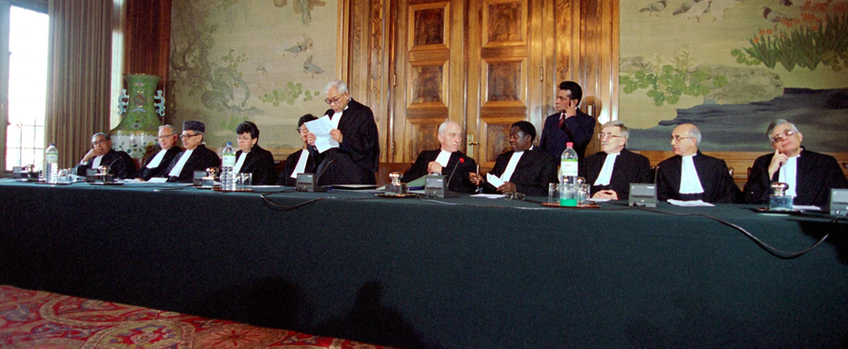
“It is difficult to envisage circumstances in which rape, by, or at the instigation of a public official, or with the consent or acquiescence of an official, could be considered as occurring for a purpose that does not, in some way, involve punishment, coercion, discrimination or intimidation.”
– Delalic et al. (ICTY, Nov. 16, 1998)
© ICTJ 2018
Notes:
Photo: First session of the ICTY. (UN/ICTY)

Slide 28
Key Hybrid Court Rulings on Gender
Brima (SCSL, 2007)
Case 002 indictment (ECCC, 2010)
Forced marriage is distinct from sexual slavery.
Forced marriage can constitute a crime against humanity.
The ECCC was one of the first courts to recognize acts of SGBV against men as SGBV.
The ECCC used gender-neutral language to describe forced marriage: “both men and women were forcibly married” under the Khmer Rouge.

Slide 29
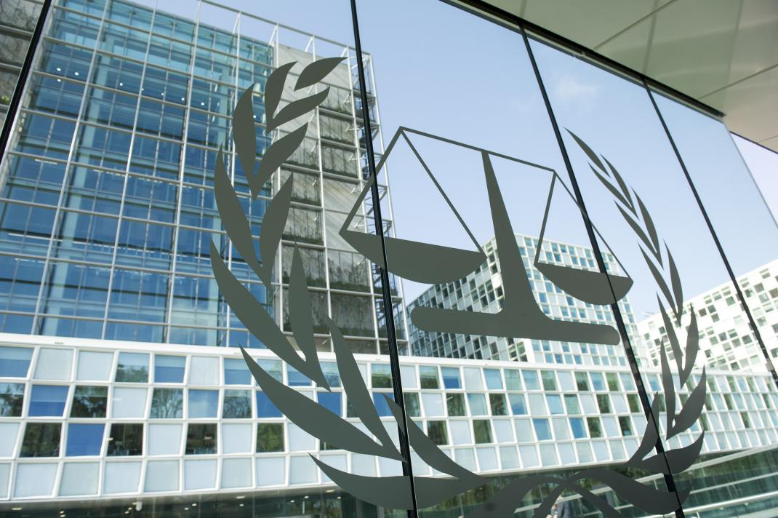
6. The Rome Statute and the ICC
First and only permanent international criminal tribunal.
It explicitly recognizes that SGBV can constitute war crimes, crimes against humanity, and/or genocide.
OTP’s official policy outlines how gender should be integrated from the beginning preliminary examinations phase and throughout the criminal justice process.
But jurisprudence has not meaningfully advanced gender justice.
© ICTJ 2018
Notes:
Photo: The Permanent Premises of the International Criminal Court in The Hague, Netherlands. (UN Photo/Rick Bajornas)

Slide 30
Rape, sexual slavery, enforced prostitution, forced pregnancy, enforced sterilization, or any sexual violence of comparable gravity can constitute:
genocide (Rome Statute, Art. 6(b), 6(d));
crimes against humanity (Art. 7(g)); and/or
war crimes (Art. 8(2)(b)(xxii) for international wars and Art. 8(2)(c)(vi) for non-international wars).
Persecution against any identifiable group or collectivity on gender grounds can constitute crimes against humanity (Art. 7(h)).
© ICTJ 2018

Slide 31
Mixed Legacy on Gender at the ICC
Katanga (2014)
Lubanga (2012)
Bemba (2016)
Al-Hassan (ongoing)
He was convicted of all charged war crimes and crimes against humanity except the rape and sexual slavery charges.
The conviction sent a message that SGBV is more acceptable than non-gendered crimes and damaged the ICC’s credibility with victims of SGBV.
The indictment excluded SGBV charges, despite publicly available information about its occurrence.
Since evidence about SGBV came up during trial, some hoped the court would order reparations for SGBV against girl child soldiers.
But no reparations would be given for SGBV since these crimes were not charged.
The first indictment charging SGBV against men as rape.
The ICC’s first conviction for SGBV crimes via command responsibility.
His conviction was unanimously overturned two years later in June 2018.
The ICC has yet to convict for SGBV to date.
One of the first times the ICC has attempted to indict on the basis of gender-based persecution.
His official confirmation of charges meeting is currently scheduled for May 2019.

Slide 32
7. Establishing Priorities
Prosecutions can better understand SGBV crimes, as well as how social and political systems exacerbate violence against women through:
mapping exercises;
consultations with women’s groups and key stakeholders.
© ICTJ 2018

Slide 33
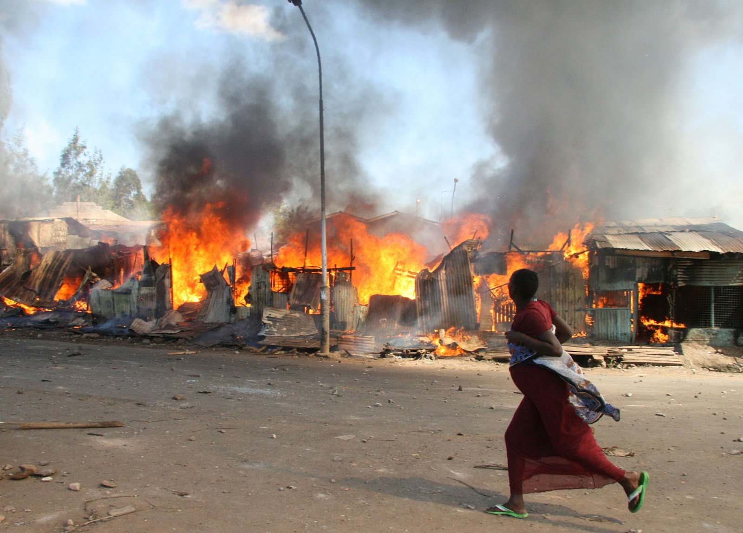
Identifying Acts of Harm and Patterns of Violations
Mapping exercise can help determine what kinds of crimes occurred, when and where they occurred, who the victims were, and the likely identity of perpetrators and their chain of command.
Mapping exercises should be used to identify patterns of violations.
Pattern is a set of events that together imply some degree of planning and centralized control.
Evidence of patterns can help prove that a particular crime was part of a planned process.
© ICTJ 2018
Notes:
Photo: A woman runs during the post-election violence in Kenya. (IRIN/Joseph Mwelu)

Slide 34

Rwanda
Notes:
Photo: The Hutu army produced propaganda posters to increase their following. (66MILLAWINNER/Emaze, https://www.emaze.com/@AFWWTLRQ/Rwandan-Genocide)

Slide 35
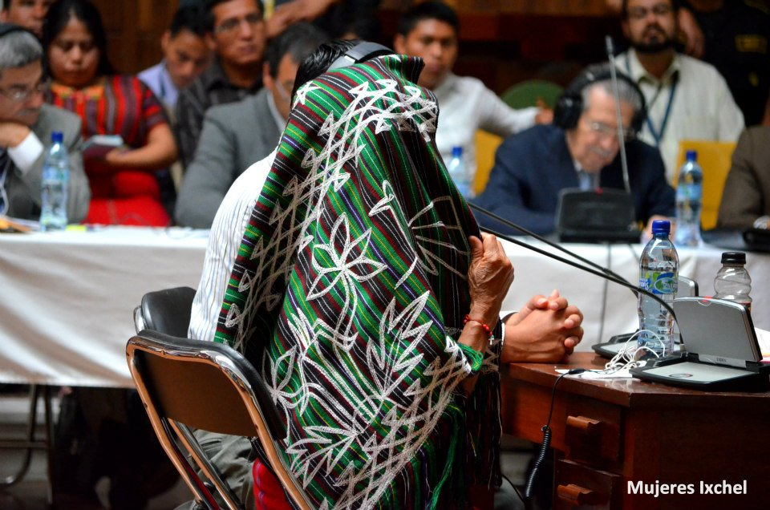
Importance of Consulting Women’s Groups and Other Key Stakeholders
More thoroughly capture the gender dimension of international crimes
Ensure that victims have a direct say regarding the definition of violations
Understand the financial and emotional needs of victims and witnesses
Understand potential challenges in the selection of cases as well as victims and witnesses
© ICTJ 2018
Notes:
Photo: During their testimony on sexual violence, some Guatemalan women preferred to cover their faces. (Mujeres Ixchel)

Slide 36
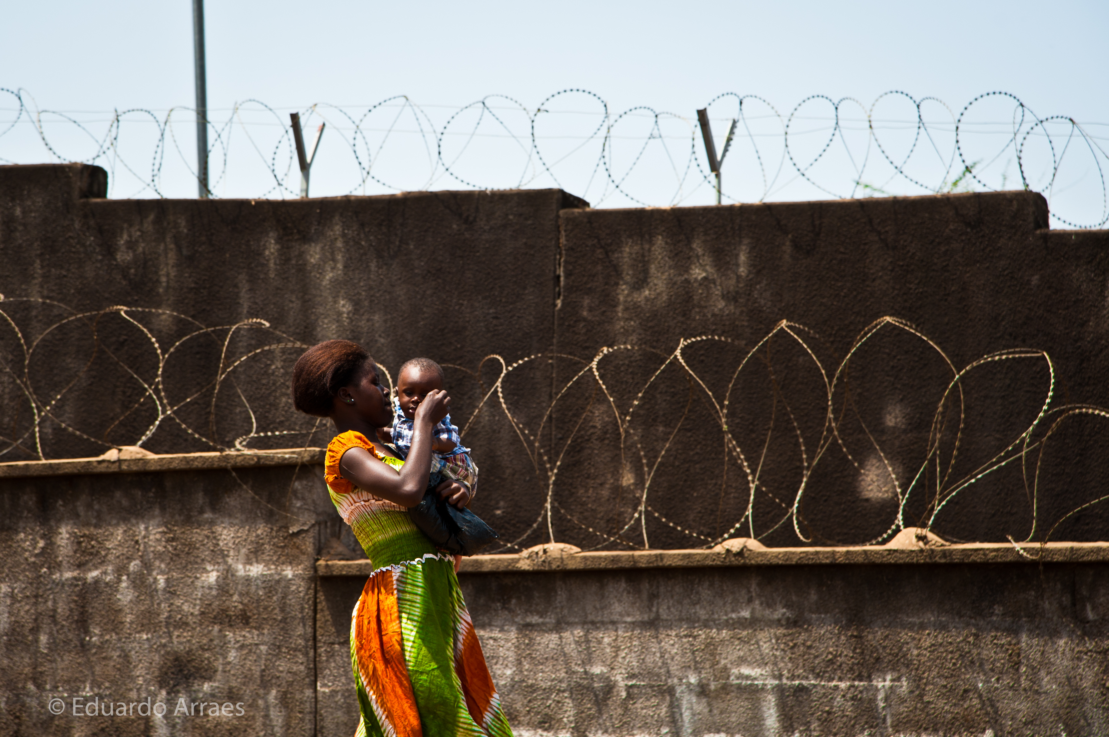
Sierra Leone
Notes:
Photo: A Sierra Leonean woman carries her baby past the outer walls of the special court compound. (“Caring,” Flickr/Eduardo Fonseca Arraes)

Slide 37
8. Bias as a Challenge to Prosecuting SGBV
Victims of SGBV experience bias, discrimination, and blame from their families, communities, police, and judicial actors.
Fear of stigma and rejection by family can deter victims from reporting or cooperating with prosecutions.
Prosecutors can be reluctant to try SGBV crimes because of evidentiary problems and subjective misconceptions about SGBV and its victims.
© ICTJ 2018

Slide 38
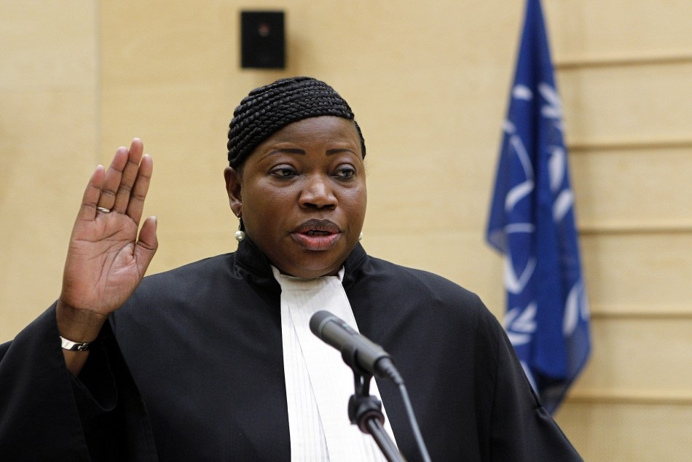
9. Importance of Staffing
Dedicated gender experts on staff, including the judicial bench, helps successfully adjudicate SGBV crimes.
Gender representation and expertise should be a factor in the recruitment of staff, prosecutors, and judges.
All staff members should receive gender training on a regular, ongoing basis.
© ICTJ 2018
Notes:
Photo: Fatou Bensouda is appointed as Prosecutor of the International Criminal Court. (ICC)

Slide 39
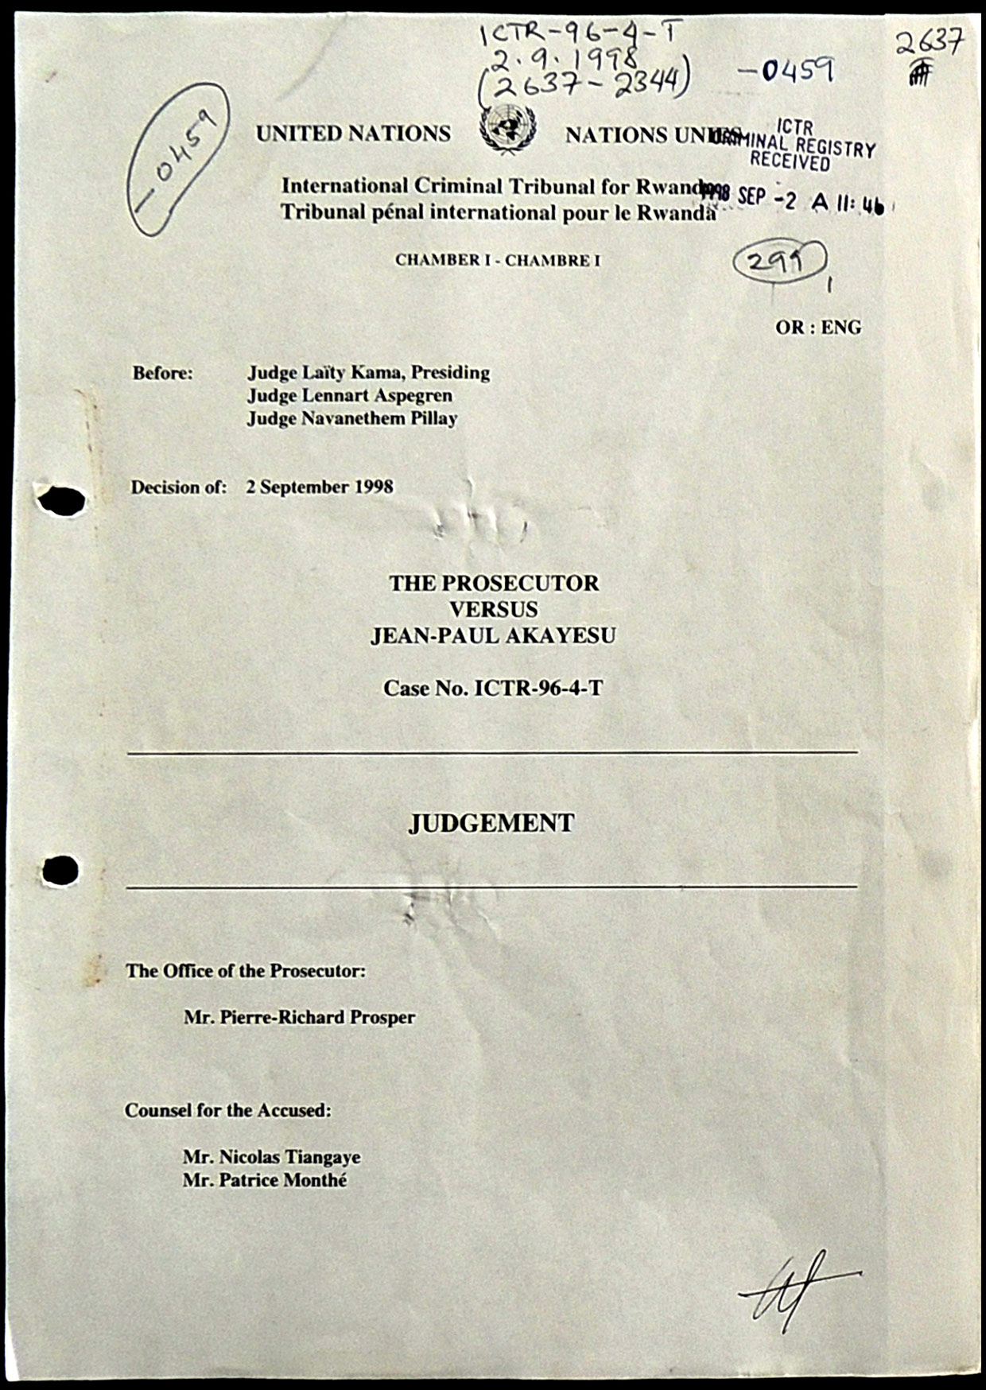
Rwanda
© ICTJ 2018
Notes:
Photo: The first page of Akayesu’s ICTR judgment. (UN Photo)

Slide 40
10. Procedural Considerations
The most important guiding principle in investigations is do no harm.
Victims and witnesses may need logistical support and medical care to enable their travel to testify, witness protection, and psychosocial support throughout the criminal justice process.
National jurisdictions struggle more than international prosecutions with respect to such considerations.
© ICTJ 2018

Slide 41
Investigations and Statement-Taking
Prosecutions are not inherently victim-centric.
Statement-taking aims to extract information — not to provide the victim with space to tell their story (as is the case with truth commissions).
Statement-takers and investigators must be sensitive, including to gender issues.
© ICTJ 2018

Slide 42
Good practices for sensitive statement-taking include:
Tips to express compassion
Acknowledge gravity
Allow victim to vent
Demonstrate empathy
Allow victim to regain control
Make eye contact
Avoid physical touch
Tips for sensitive communication
Ask open-ended questions
Explain rationale behind questions
Use context-specific terminology for sensitive issues
Solicit the narrative first, then ask more clarifying questions
© ICTJ 2018

Slide 43
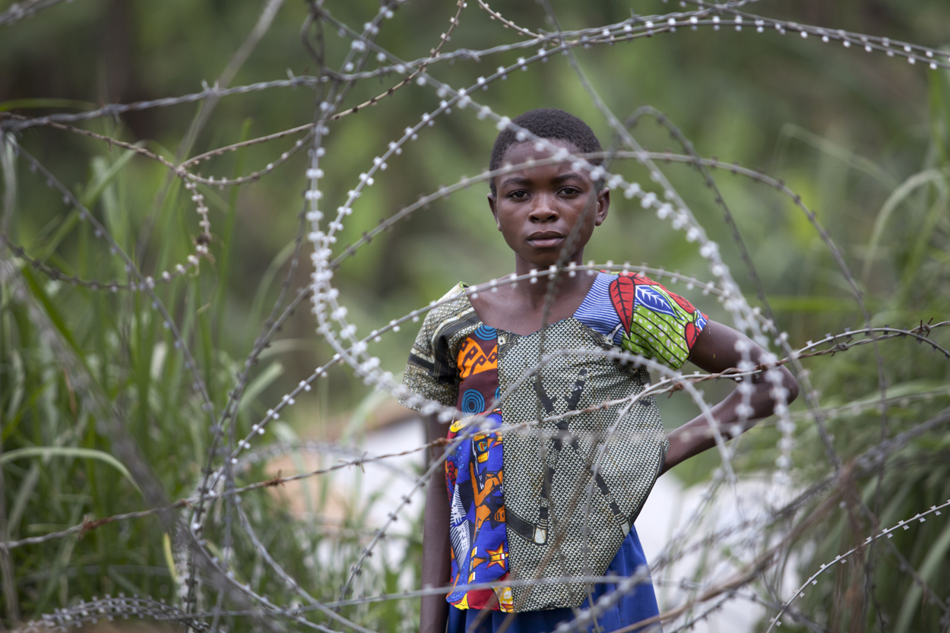
Do No Harm
Staff should conduct a risk analysis of social, psychological, and security threats to victims and witnesses.
The court should take every possible step to reduce or mitigate these risks.
If risks cannot be reduced or mitigated, then the court should not involve the victim or witness in the process.
© ICTJ 2018
Notes:
Photo: A displaced girl stands outside in North Kivu, Democratic Republic of Congo, on March 2, 2012. (MONUSCO/Sylvain Liechti)

Slide 44
Some other important considerations
Allow choice of same-sex interviewer with proper training and experience
Represent various ethnic, language, age, and other relevant groups in investigation team
Use interview site that is private and comfortable
Conduct interviews one-on-one unless the victim desires the presence of a support person
© ICTJ 2018

Slide 45
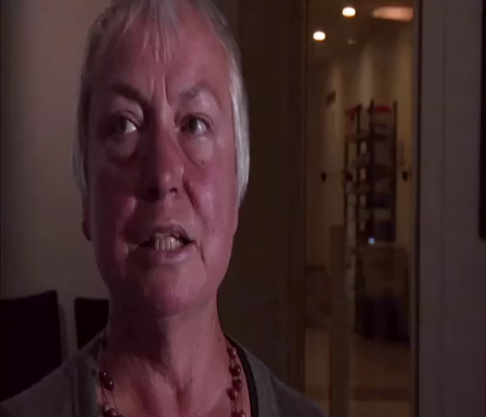
I Came to Testify
© ICTJ 2018
Notes:
Show I Came to Testify video clip [English].

Slide 46
Support for Victims and Witnesses
The prosecution is responsible for the safety of victims and witnesses, including through the provision of:
logistical support to testify;
victim and witness protection;
psychosocial support.
© ICTJ 2018

Slide 47
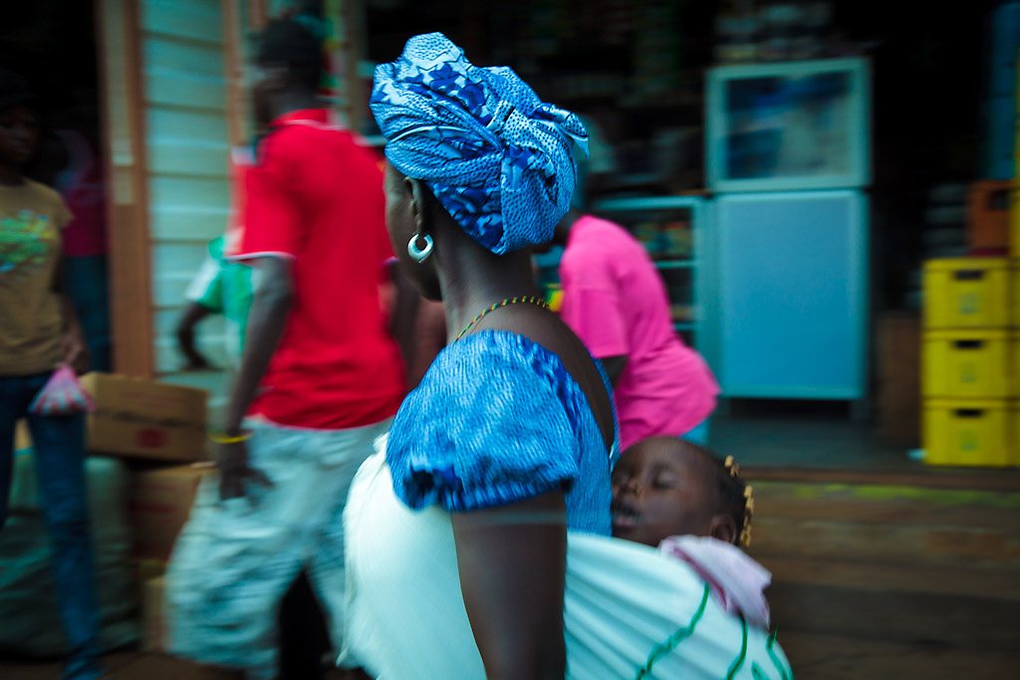
Sierra Leone
Notes:
Photo: A woman in Sierra Leone walks with her infant child. (Flickr/Bobthemagicdragon)

Slide 48
Example Protections for Victims/Witnesses
Confidentiality
The ICC may expunge the identity of victims and witnesses from the record, electronically alter pictures and voices, and/or use pseudonyms for victims and witnesses.
Alternative means of giving evidence
The ICC may conduct in camera proceedings and allow the introduction of audio or video testimony and written transcripts as evidence.
Relocation
The ICC has entered into relocation agreements with states regarding temporary or permanent relocation. Relocation is a last-resort measure considered if and only if no other protection measure is sufficient.
© ICTJ 2018

Slide 49
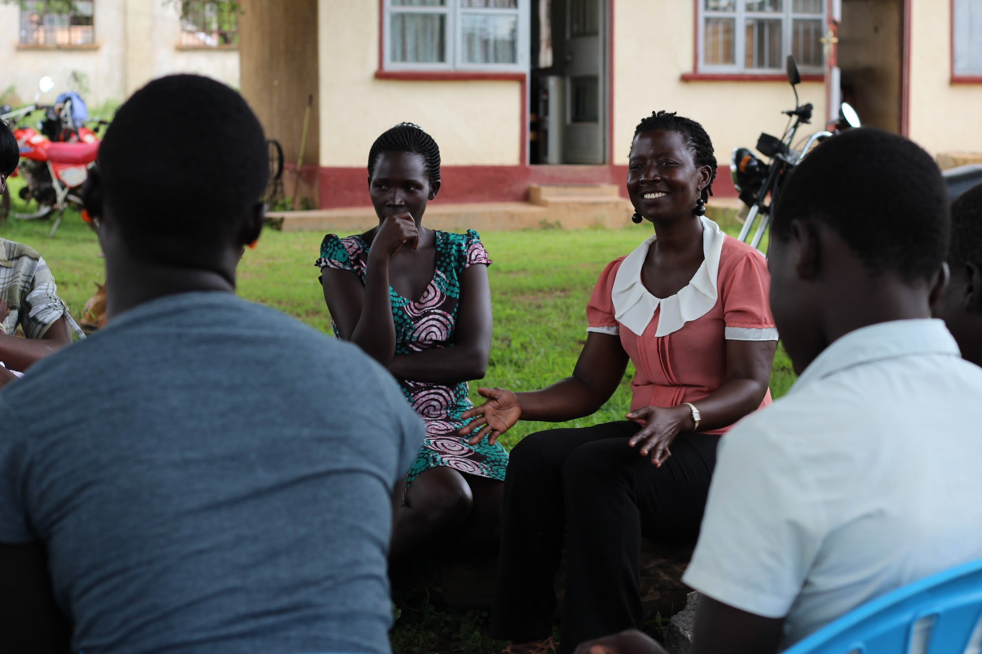
Uganda
Notes:
Photo: Women formerly abducted by the Lord’s Resistance Army counsel children born in captivity through their NGO, Watye Ki Gen. (ICTJ/Marta Martinez)

Slide 50

Evidentiary Considerations
Acts of SGBV pose evidentiary challenges because they:
often do not leave visible scars;
are difficult to prove with forensic evidence;
rely on individual testimony, which is difficult to corroborate since there are often no witnesses or medical records.
© ICTJ 2018
Notes:
Photo: Srebrenica, Bosnia and Herzegovina. (Flickr/Mikel Oibar)

Slide 51
Good Evidentiary Practices
No need to corroborate SGBV testimony
Consent cannot be inferred
Evidence of the prior sexual conduct of the victim is prohibited
Consent is not allowed as a defense if the victim:
    was subjected to/threatened by violence or if they had reason to fear violence, duress, detention, or psychological oppression;
    reasonably feared that if they did not submit to the assault, another individual would be subjected to/threatened by violence, duress, detention or psychological oppression.
© ICTJ 2018

Slide 52
11. Outreach to Communities
Outreach is essential to:
Manage expectations regarding victims’ participation and the criminal justice process
Disseminate courts judgments and findings to victims and communities
© ICTJ 2018

Slide 53
Managing Expectations
Victims and communities need to understand:
prosecutorial strategies;
realistic timeframes;
realistic outcomes (such as disappointing verdicts and/or sentences);
potential for re-traumatization and forms of support available to them.
© ICTJ 2018

Slide 54

I Came to Testify
© ICTJ 2018
Notes:
Show I Came to Testify video clip of woman who gave her statement and has been waiting for years [English].

Slide 55
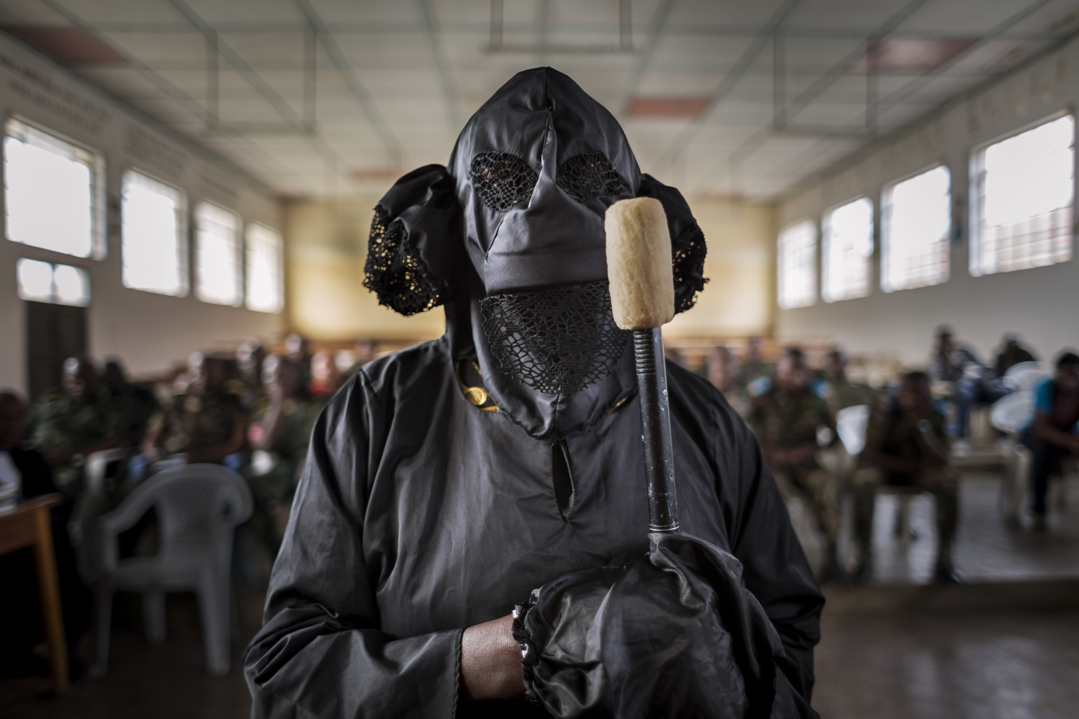
Democratic Republic of the Congo
Notes:
Photo: A woman—veiled to protect her identity from the public—testifies about having been raped at the Minova trial. A lawyer holds the microphone for her. Accused soldiers are seated in the rear. (Diana Zeyneb Alhindawi, © 2014)

Slide 56
Dissemination of Findings
Judgments should be made accessible to victims and affected communities, including through:
Physical dissemination (with translation) of the full judgment and appellate decisions
Dissemination of key parts via other accessible mediums, such as radio
© ICTJ 2018
Notes:
Photo: A news board in Liberia during the trial of Charles Taylor held in The Hague. (Wikimedia Commons/Lieutenant Colonel Terry VandenDolder)

Slide 57
12. Re-
conceptualizing Gender within and beyond Criminal Justice
Prosecutions are necessary but not sufficient.
Prosecutions do not account for many gendered patterns and structures of human rights abuses beyond SGBV.
When prosecutions fail to hold perpetrators of SGBV accountable, they entrench problematic precedents about which acts are deserving justice.
© ICTJ 2018

Slide 58
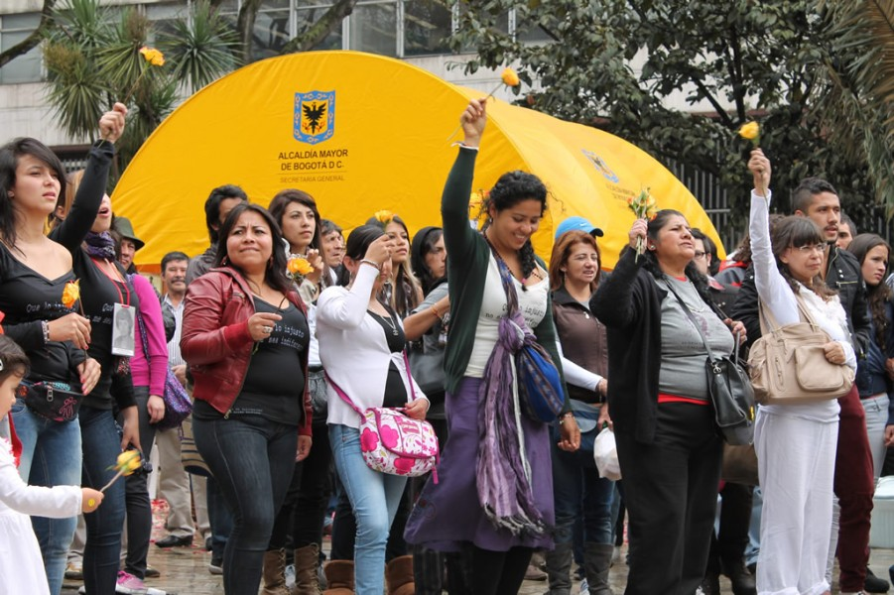
Moving Forward…
Prosecutions should:
Highlight gendered patterns of abuses
Open a national conversation about the enabling conditions of sexual and gender-based violations
Mobilize institutional reform
Increase political support for women’s access to justice
© ICTJ 2018
Notes:
Photo: Women march together during the first ever celebration of Colombia’s National Day of the Memory and Solidarity with the Victims on April 9, 2012. (ICTJ/Astrid Elena Villegas)

