Slide 1
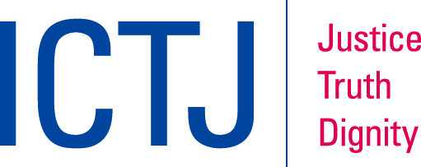
GENDER AND TRANSITIONAL JUSTICE: MEMORIALIZATION
Funded by the European Union
Notes:
This presentation was produced as part of the series, Gender and Transitional Justice: A Training Module Series by the International Center for Transitional Justice (ICTJ). These modules were produced with the financial support of the European Union. Their contents are the sole responsibility of ICTJ and do not necessarily reflect the views of UN Women and the European Union. October 2018.

Slide 2
Introduction
Memorials are a way to commemorate victims and reflect the complexity of the problems that follow from widespread violence and state repression.
There is no one approach or formula for memorializing victims - every community will have different priorities and expectations; differences will exist within communities as well.
However, memorials often overlook or mischaracterize the complexity of women and girls’ roles - “split memory” refers to the way the “trauma of war and genocide is memorialized differently for men and women.”
© ICTJ 2018

Slide 3
Memory projects cannot be understood separately from the power dynamics that exist in a given society, including those related to gender.
When women have a role in designing memorials, the reach and power of their voices grows. With input from women, memorials can begin to challenge the dominant narratives that often favor men and perpetuate discriminatory norms.
© ICTJ 2018

Slide 4
2. Why Memorials?
Call attention to injustice
Recognize the struggles of those who fought against it
Acknowledge—publicly—the individuals and groups, victims and survivors who suffered
Reveal and make visible the names and stories and sometimes the faces of victims
Encourage societies to critically examine what happened and why and reach some common understanding of the past around which reconciliation can begin
© ICTJ 2018

Slide 5
Memorials can be participatory and reciprocal: drawing visitors in, captivating them, eliciting a response, and, when designed to be interactive, inviting collaboration.
Some of the most successful memorials combine the sacred and the secular, research and education, protest and critique, and mourning and reflection.
© ICTJ 2018

Slide 6
Victims’ Priorities and the Potential for Politicization
Victims and their advocates may have different ideas about what they hope to achieve and how to do so.
The process of creating a memorial and its existence can become highly politicized and may create divisions.
To help mitigate the potential for problems, dialogue about memorialization efforts is essential and should not be limited to the planning stages.
© ICTJ 2018

Slide 7
3. Forms of Memorialization
Each memorialization effort is deeply dependent on local culture and the needs, preferences, and priorities of victims and victim communities.
Memorials can:
acknowledge an individual, a group or community, or large numbers of victims;
be permanent fixtures, communal activities, or interactive programs with a reconciliatory purpose;
expand and evolve over time;
exist as commemorative structures or take the form of ‘living’ places of memory.
© ICTJ 2018

Slide 8
Memorials can entail:
Dedicating commemorative monuments, plaques, statues, or other memorials to victims
Erecting tombstones or building new cemeteries
Renaming streets, buildings and public spaces
Developing educational or healthcare facilities
Building museums or public parks
Public art or conceptual art projects
Designating national days of remembrance
Conducting celebrations that offer atonement and promote reconciliation
Rededicating places of detention and torture, prisons, and military facilities
Marking and honoring mass graves
Organizing mobile museums or travelling installations, including photo, film, and video presentations or exhibits
Naming legislation in honor of victims
© ICTJ 2018

Slide 9
4. Memorials around the World: Introductory Examples
© ICTJ 2018

Slide 10
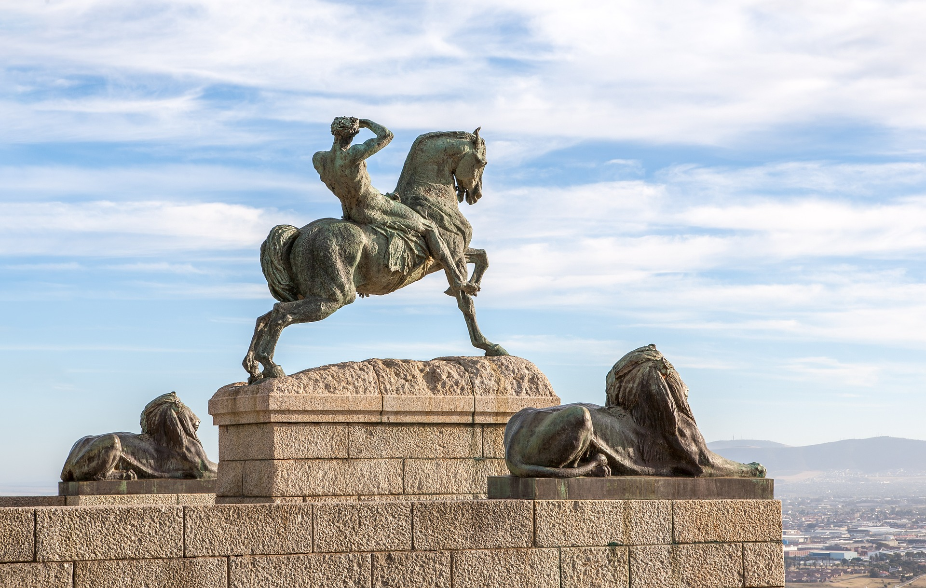
South Africa:
Rhodes Memorial
Notes:
Photo: The Rhodes Memorial in South Africa pays tribute to Cecile John Rhodes, a wealthy male politician and businessman. (Pixabay/jeanvdmeulen)

Slide 11
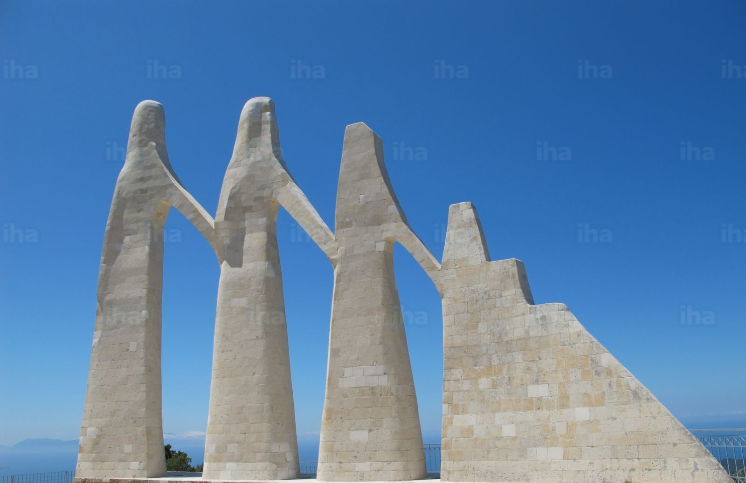
Greece:
The Women of Kassope and the Monument of Zalongo
© ICTJ 2018
Notes:
Photo: Monument of Zalongo in Greece designed by George Zongolopoulos. (IHA.com)

Slide 12
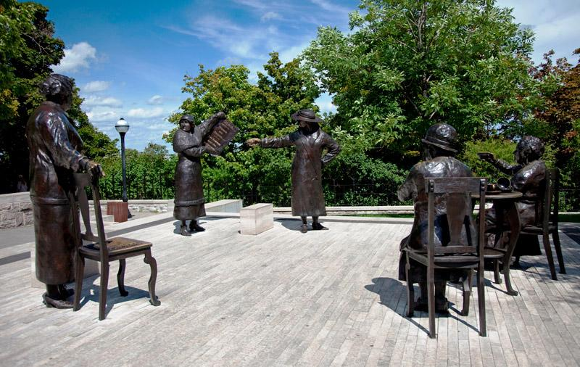
Women are Persons!
Notes:
Photo: Women are Persons! Monument in Ottawa, Canada. (Reproduced with the permission of the Minister of Canadian Heritage, 2018, © All rights reserved)

Slide 13
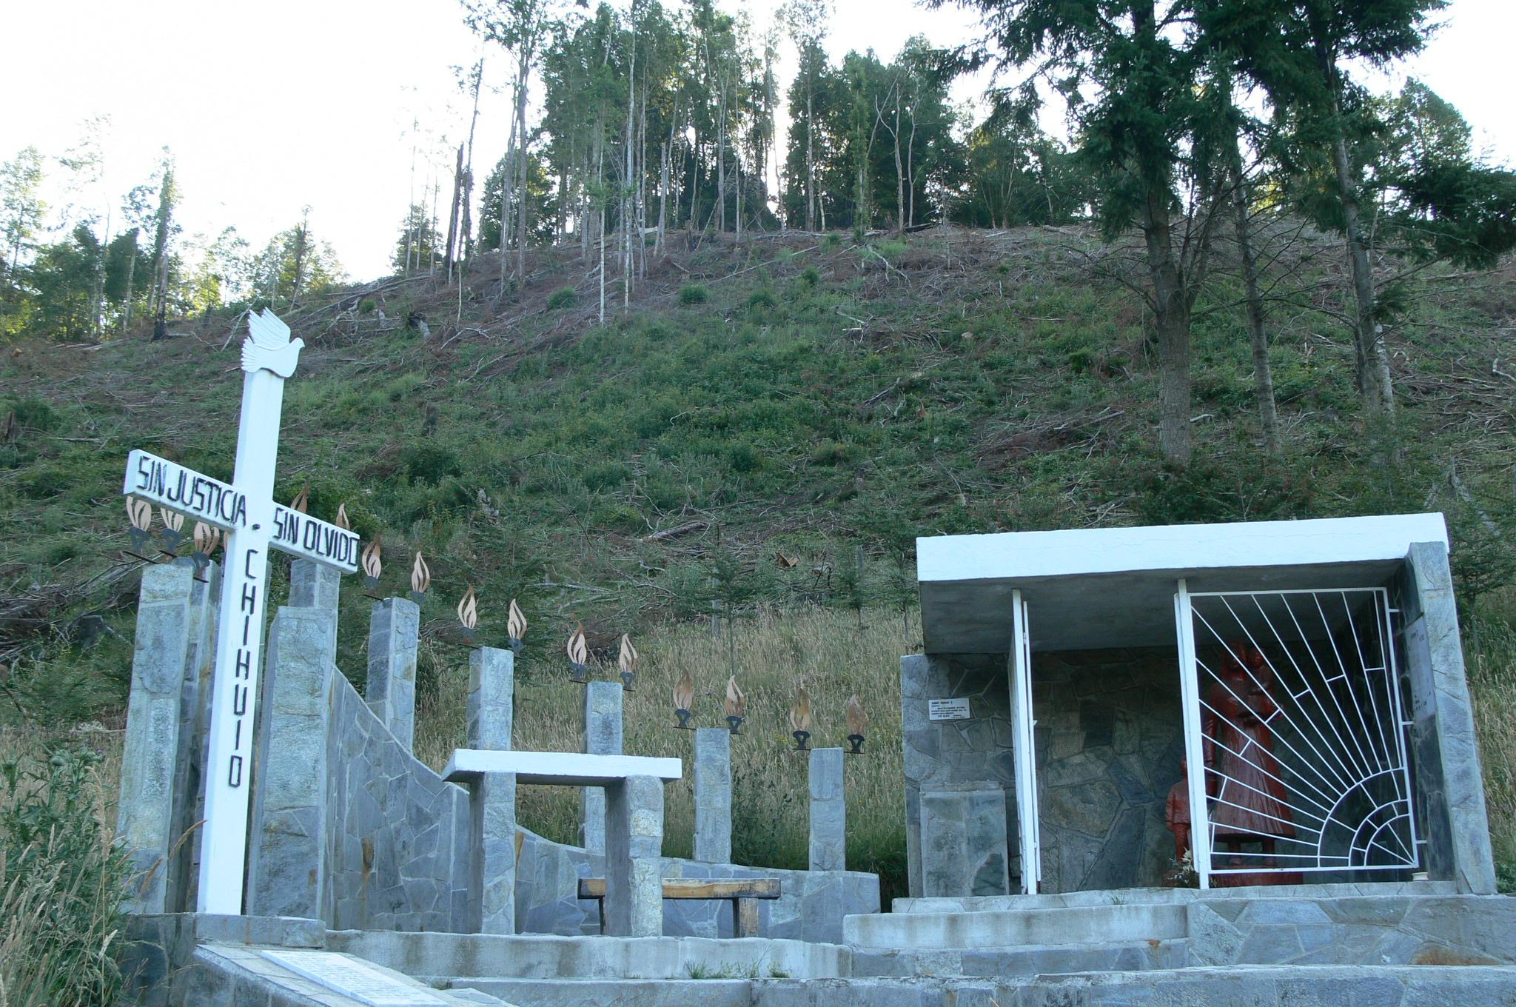
Memorial to the Victims of Chihuio
© ICTJ 2018
Notes:
Photo: Memorial to the Victims of Chihuio. (Wikimedia Commons/Museum of Memory and Human Rights)

Slide 14
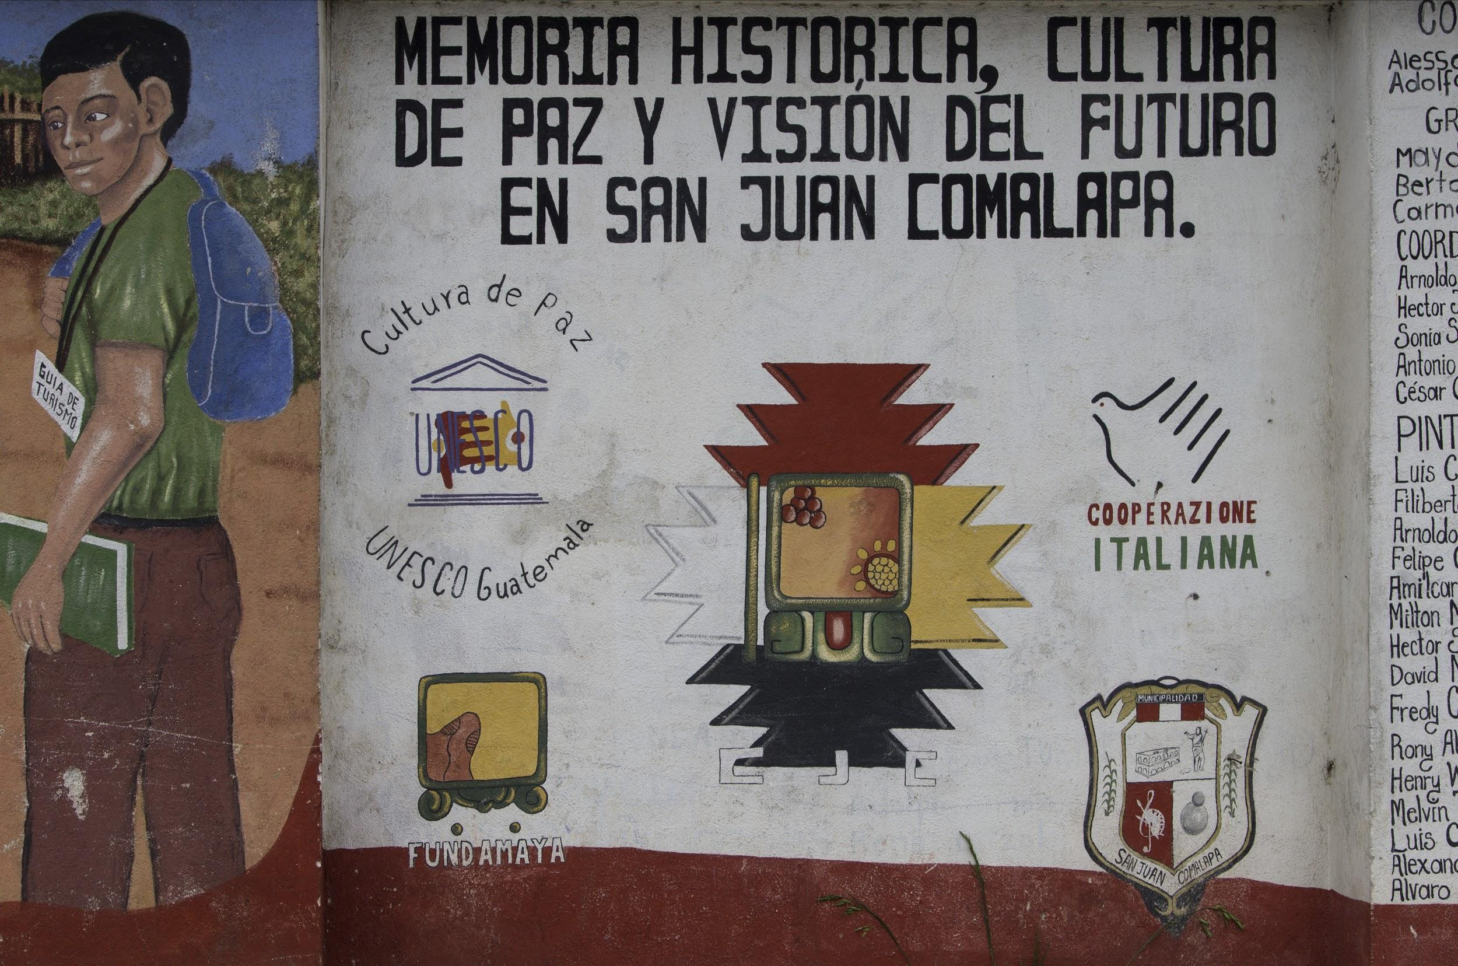
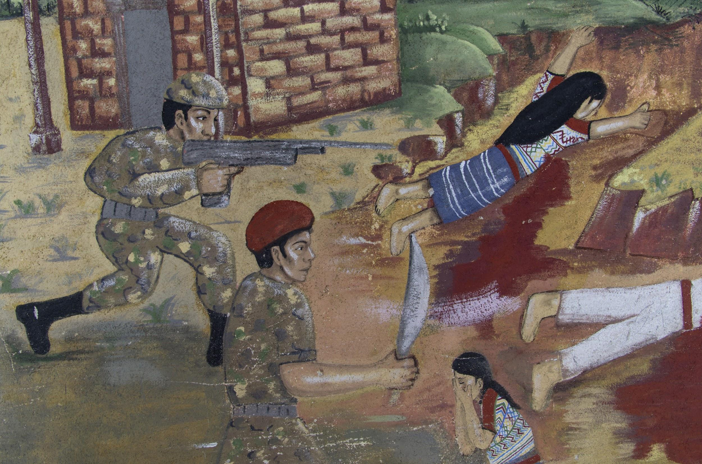
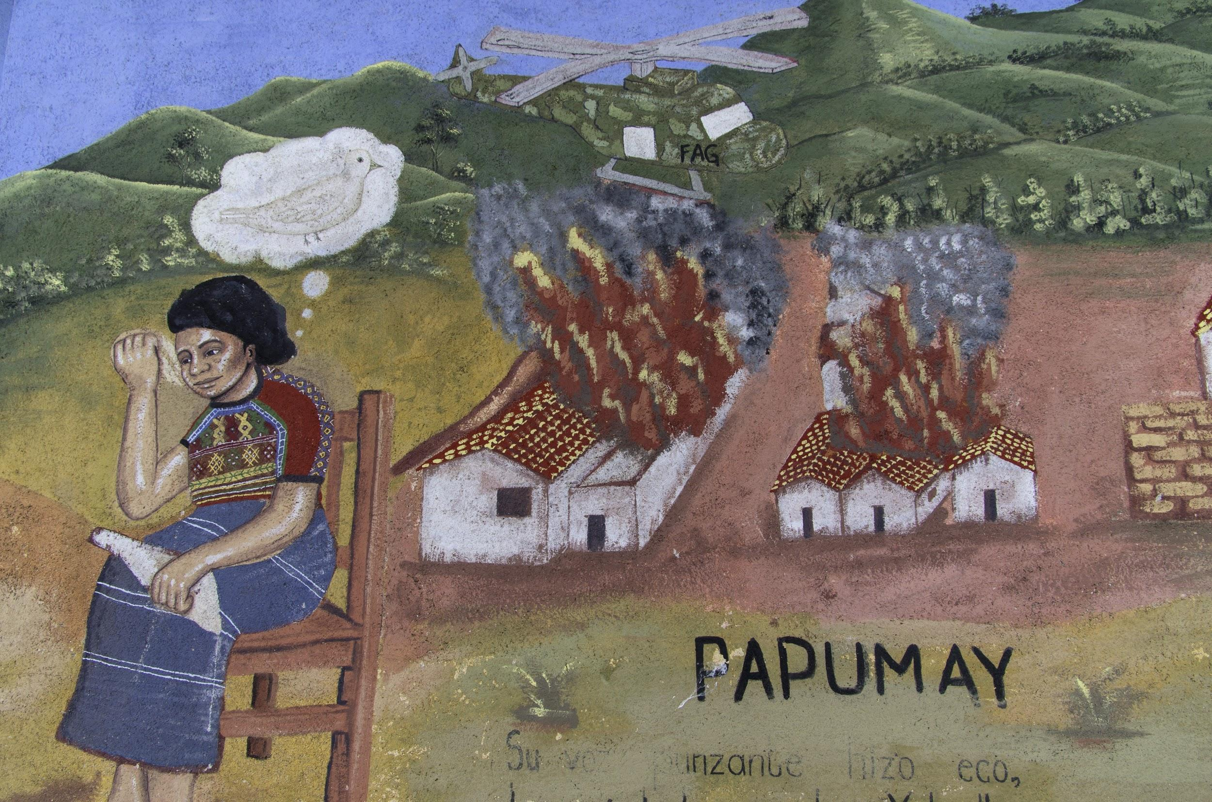
San Juan Comalapa Mural on the Violence of the 1980s
© ICTJ 2018
Notes:
Photos: A long mural in San Juan Comalapa, Guatemala, on the violence of the 1980s. (fotografia por José Mata/José Mata)

Slide 15
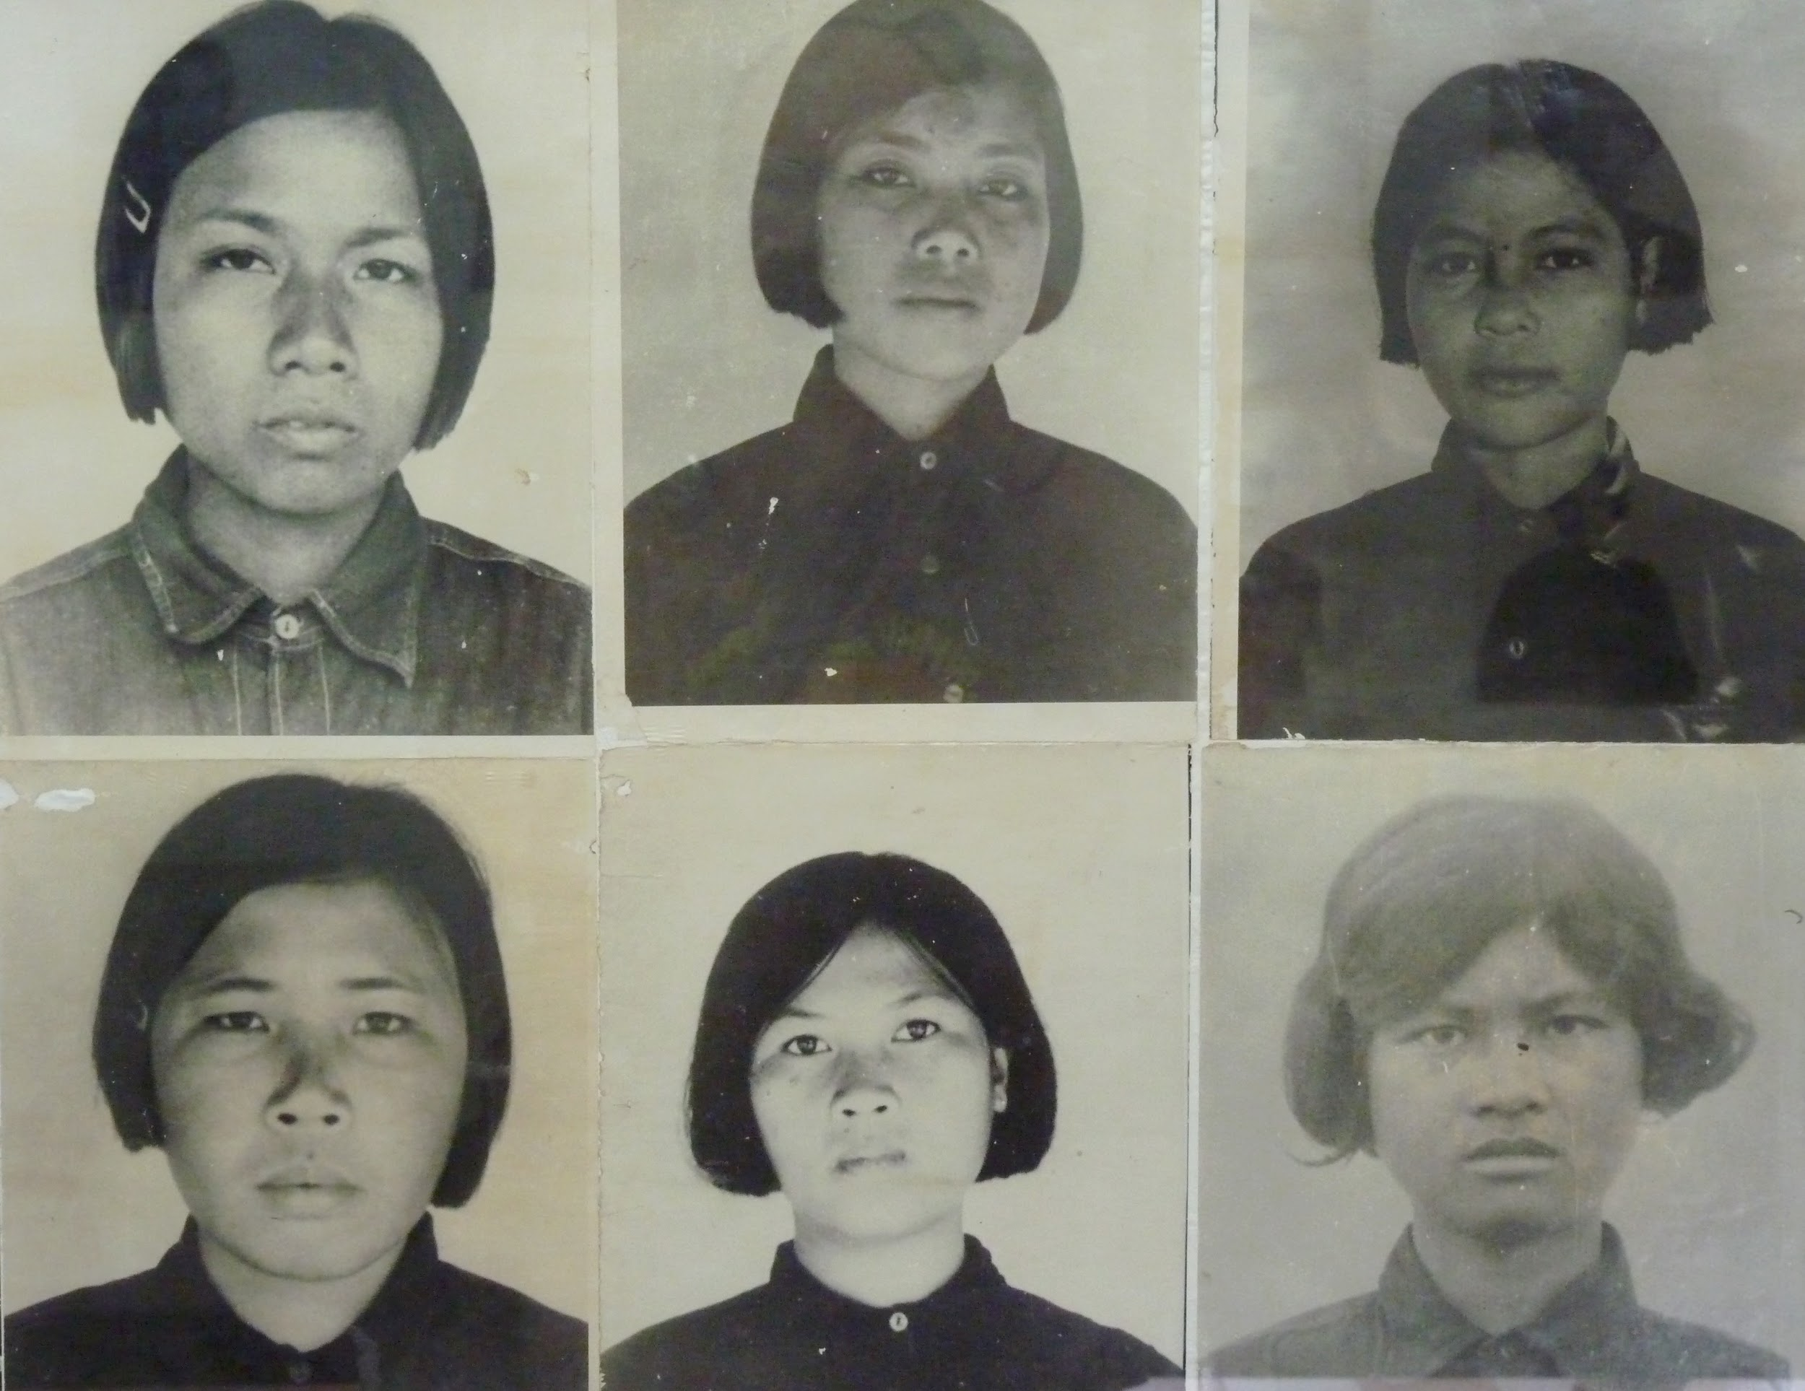
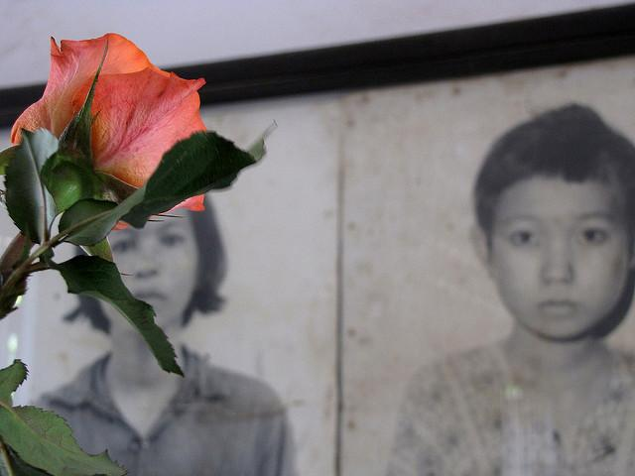
Tuol Sleng Museum of Genocide
Notes:
Photos (left to right): Tuol Sleng Museum of Genocide in Cambodia (Wikimedia Commons); a rose is placed over two photographs of women in Tuol Sleng Museum of Genocide (Flickr/Catherine Murray).

Slide 16
5. Why Is Memorialization Important for Women?
Memorials may end up replicating gendered narratives that depoliticize the role women play during conflict and when resisting oppression, as well as minimizing the nature and severity of the crimes committed against them and the harms they suffered.
If memorialization efforts are to represent and hold significance for women victims, it is especially important that they are included in decisions about who will be remembered and how.
© ICTJ 2018

Slide 17
When meaningfully engaged in memorialization efforts, women and girls can:
help other women and their families reckon with the atrocities committed in the past;
participate in defining how the past is remembered
raise awareness about human rights violations committed against women and girls in the past and those that continue today;
encourage society to recognize the political nature of women’s lives and the complexity of the roles they play during times of transition from conflict or authoritarian rule;
provide a focal point around which victims, their families, and advocates can rally when demanding acknowledgment and redress for the violations that occurred;
educate and encourage dialogue about gender discrimination and hierarchies that prevent intergroup equality, including for women.
© ICTJ 2018

Slide 18
Potential Transformative Effect
Memorials can serve as a “starting point for a society-wide appreciation of human rights. Memorials can add a new perspective to one-sided or incomplete stories about the past…A successful memorial will provoke meaningful discussion about violations without prolonging conflict.”
© ICTJ 2018

Slide 19
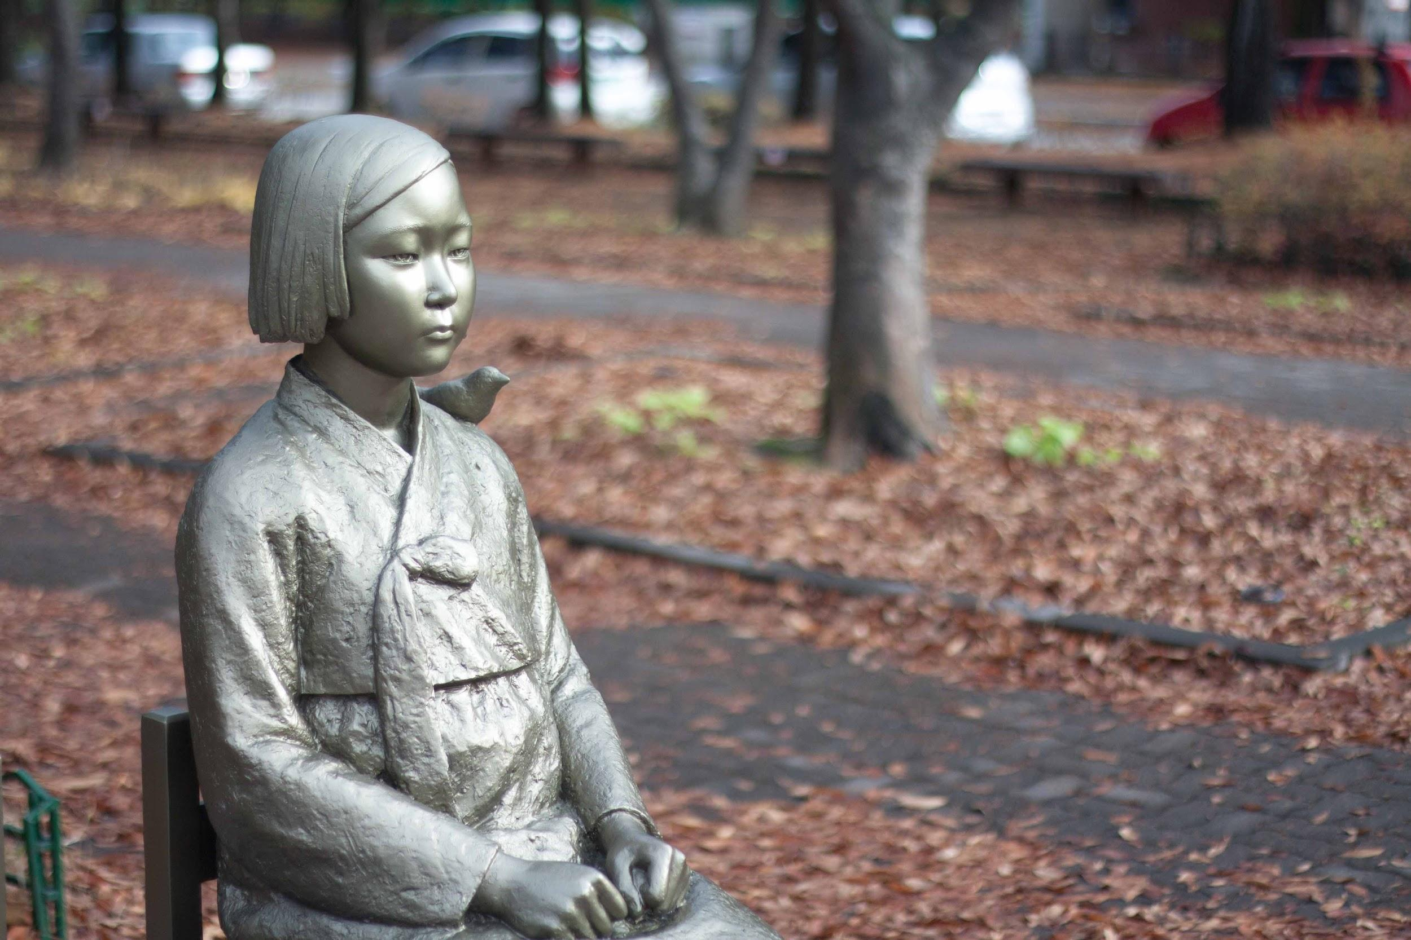
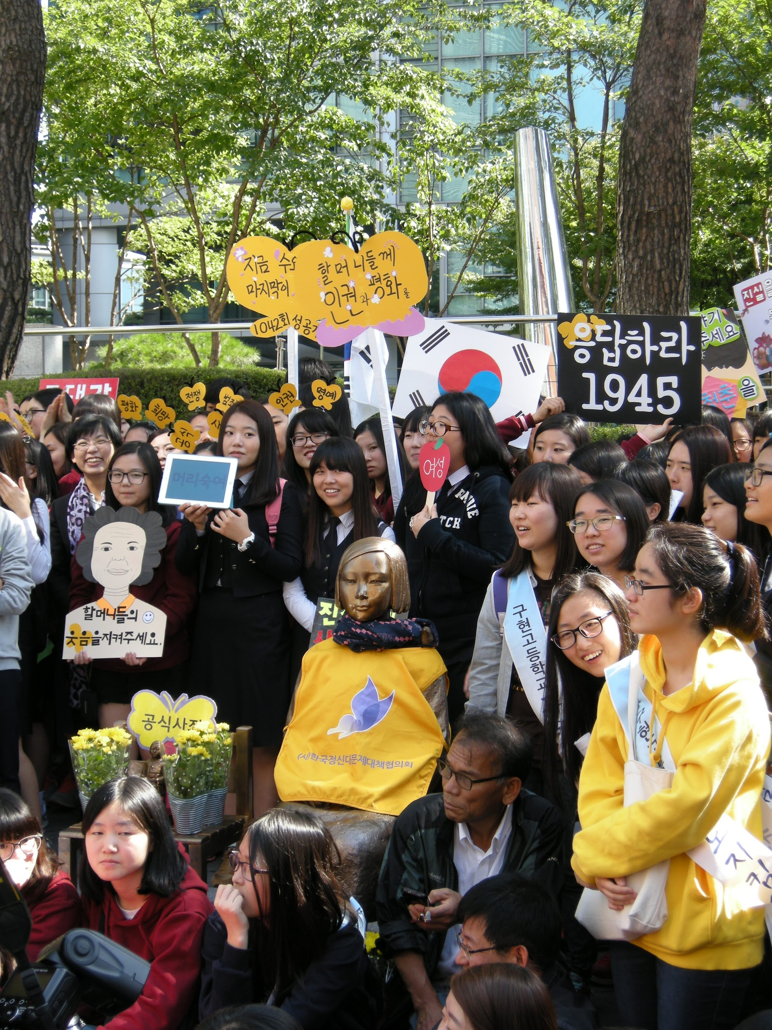
Statue of Peace (Sonyeosang)
Notes:
Photos (left to right): The Statue of Peace in South Korea (Wikimedia Commons/YunHo Lee); women protest about the “comfort women” issue at the Statue of Peace in South Korea in 2012 (Korean Wikimedia/Pudmaker).

Slide 20
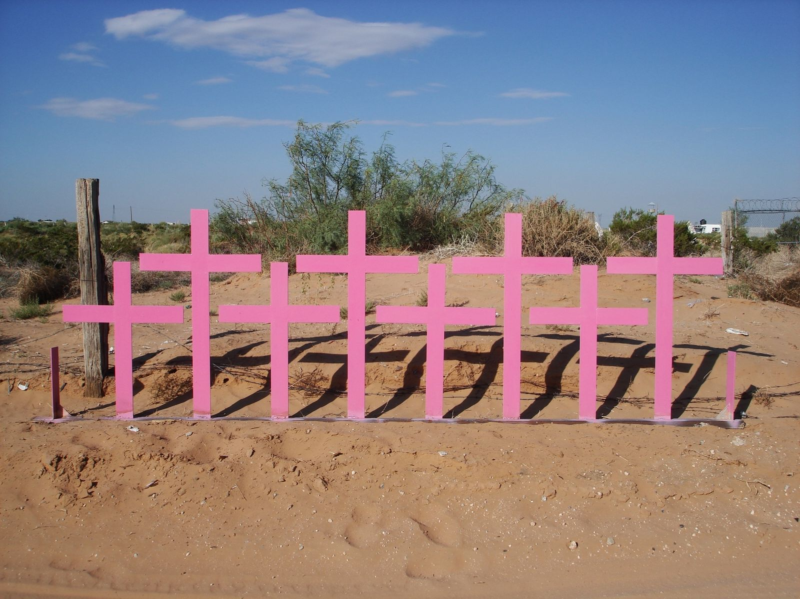
© ICTJ 2018
Notes:
Photo: Eight pink crosses commemorate the spot where the bodies of eight women were found murdered in Ciudad Juárez, Mexico. (Wikimedia Commons/lose)

Slide 21
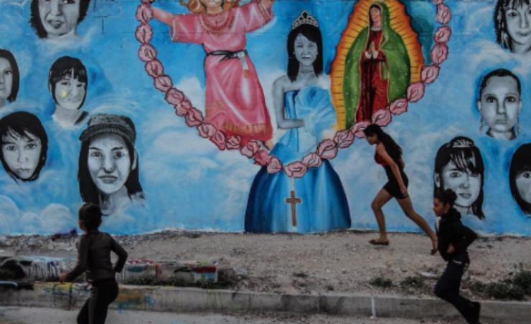
Murals in honor of missing women in
Ciudad Juárez, Mexico
© ICTJ 2018
Notes:
Photo: Mural in Ciudad Juarez entitled “Fighting Until We Find Them.” (Instagram/Alice Driver @driverwrites)

Slide 22
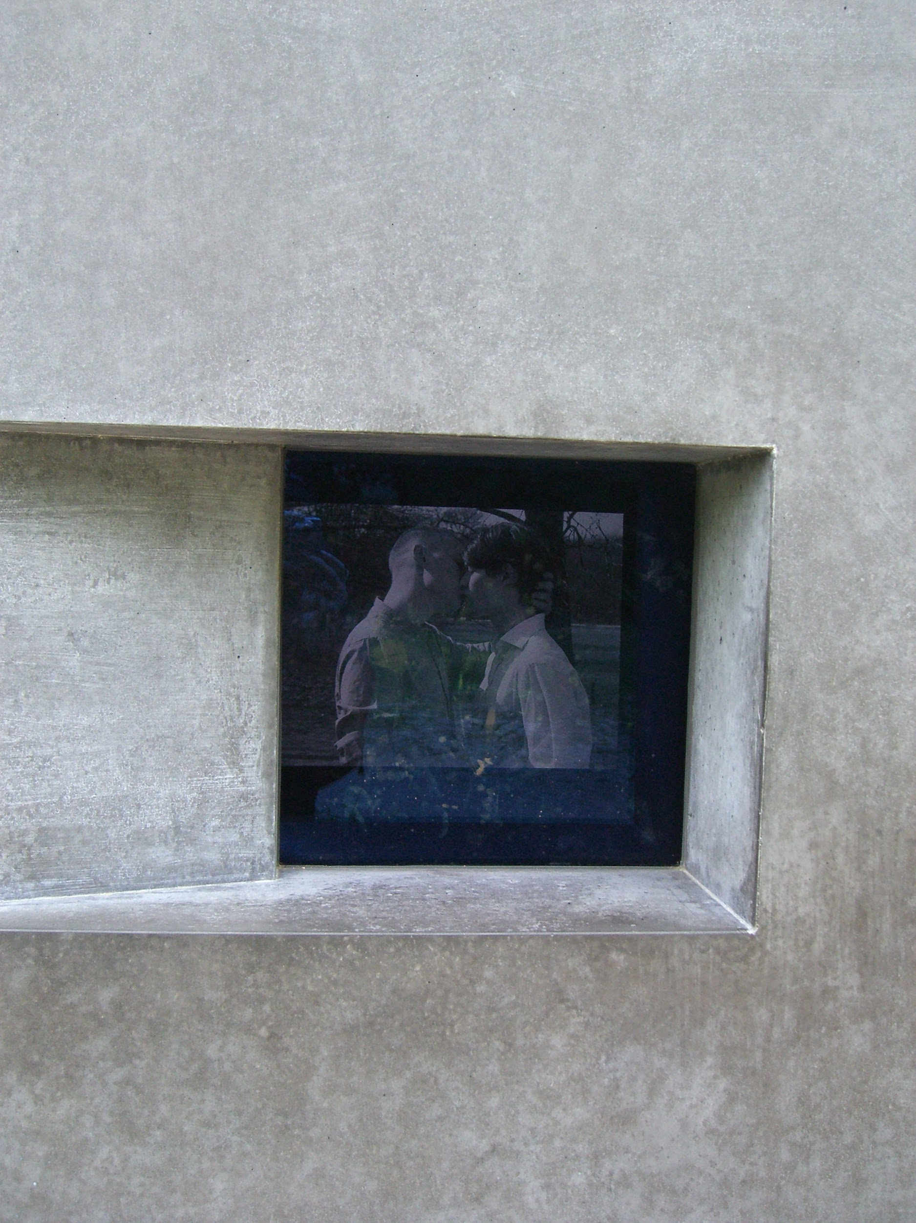
Memorial to Homosexuals Persecuted Under the National Socialist Regime
© ICTJ 2018
Notes:
Photo: The memorial to homosexuals persecuted under the national socialist regime in Germay. (Wikimedia Commons/Times)

Slide 23
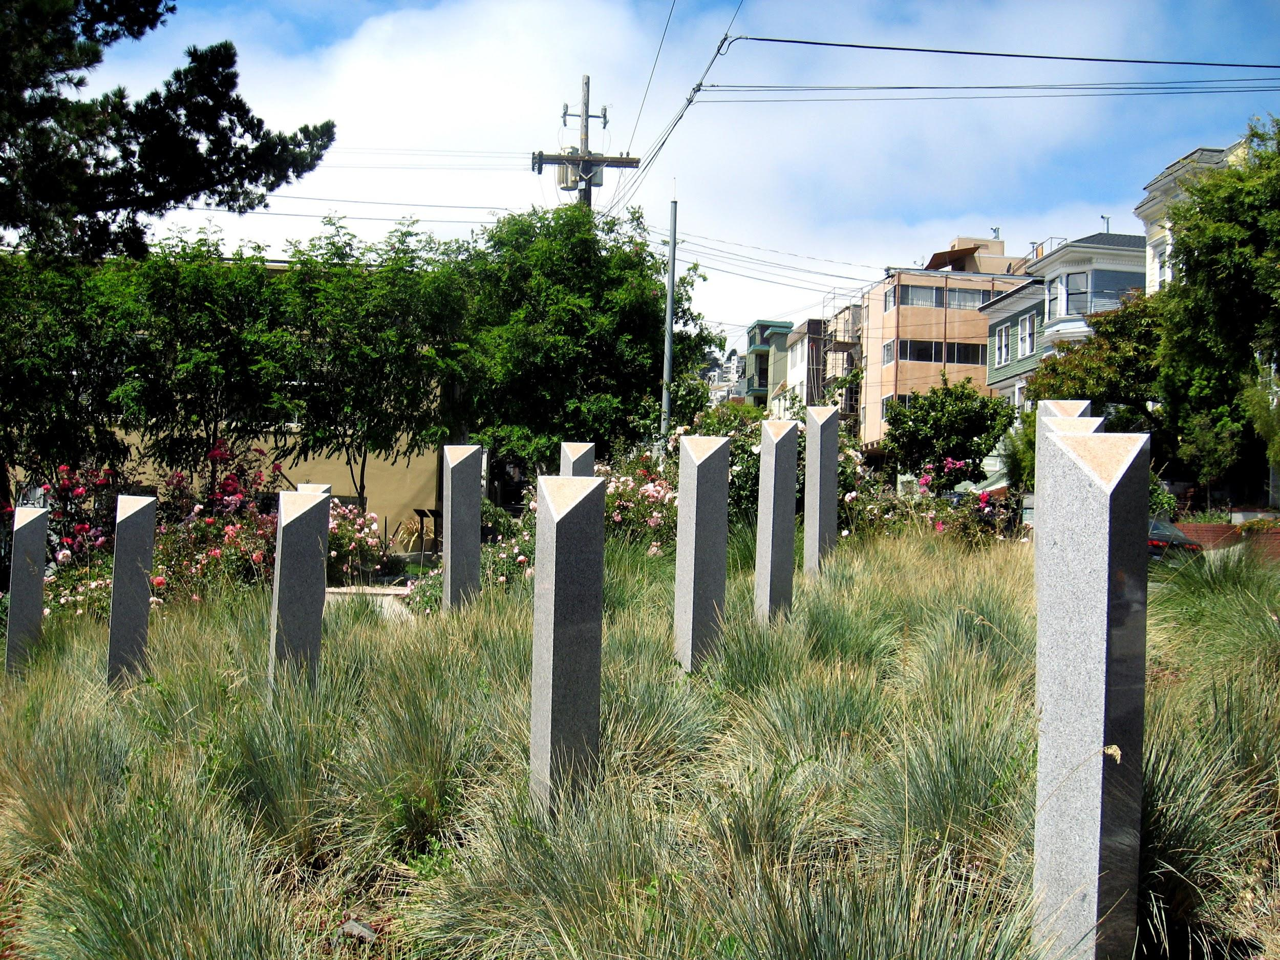
Pink Triangles
Notes:
Photos: “The Pink Triangle” exhibit in the United States. (Wikimedia Commons/Reinhard Dietrich)

Slide 24
6. Memorializing Women’s and Girls’ Experiences
Women are often portrayed as passive, disengaged victims despite having been active players who led and helped shape events. They are also often represented primarily in traditional domestic roles.
Memorialization projects can call attention to what happened to women victims during periods of dictatorship or conflict, as well as the day-to-day violence committed against women.
© ICTJ 2018

Slide 25
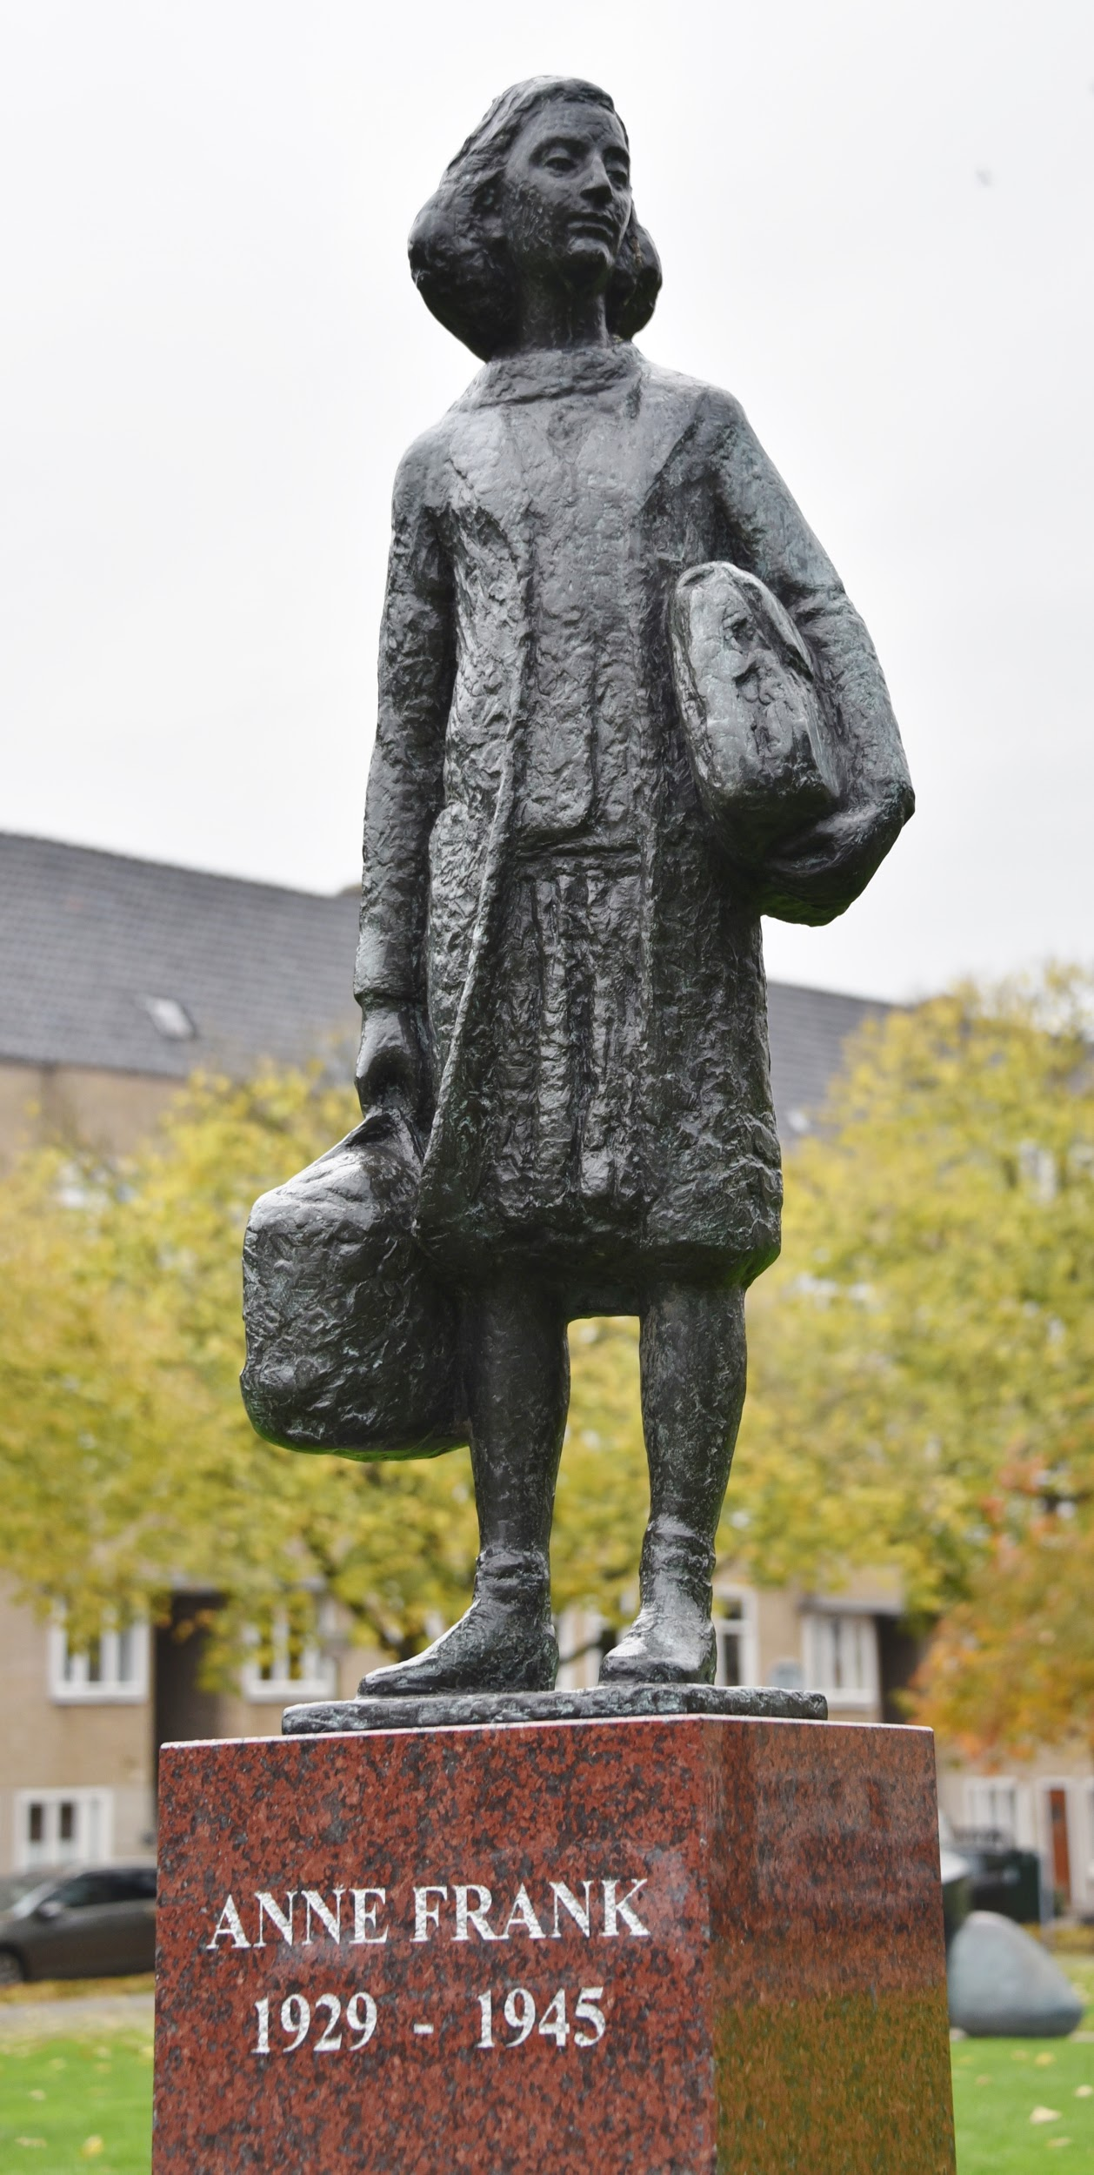
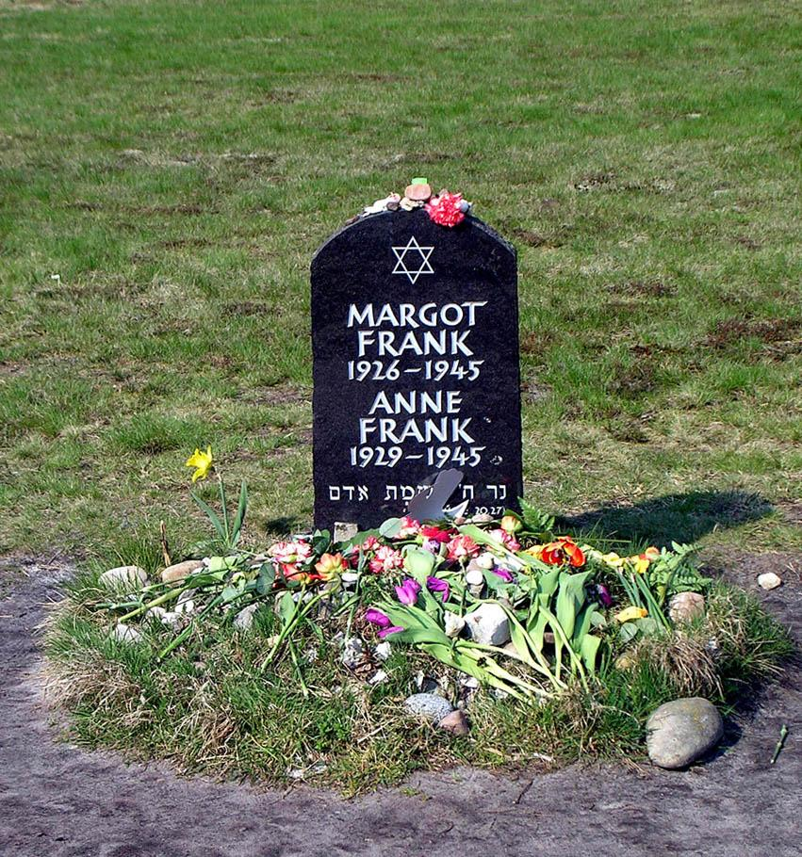
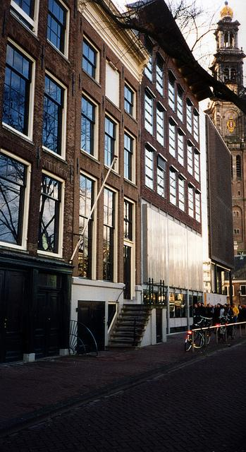
Anne Frank in the Netherlands and Germany
© ICTJ 2018
Notes:
Photos (left to right): Statue of Anne Frank in Merwedeplein, Amsterdam (Christian Michelides); Anne and Margot Frank’s memorial grave in Bergen Belsen (Wikimedia Commons/J. Tajchert); Anne Frank Museum in Amsterdam (Flickr/InSapphoWeTrust).

Slide 26
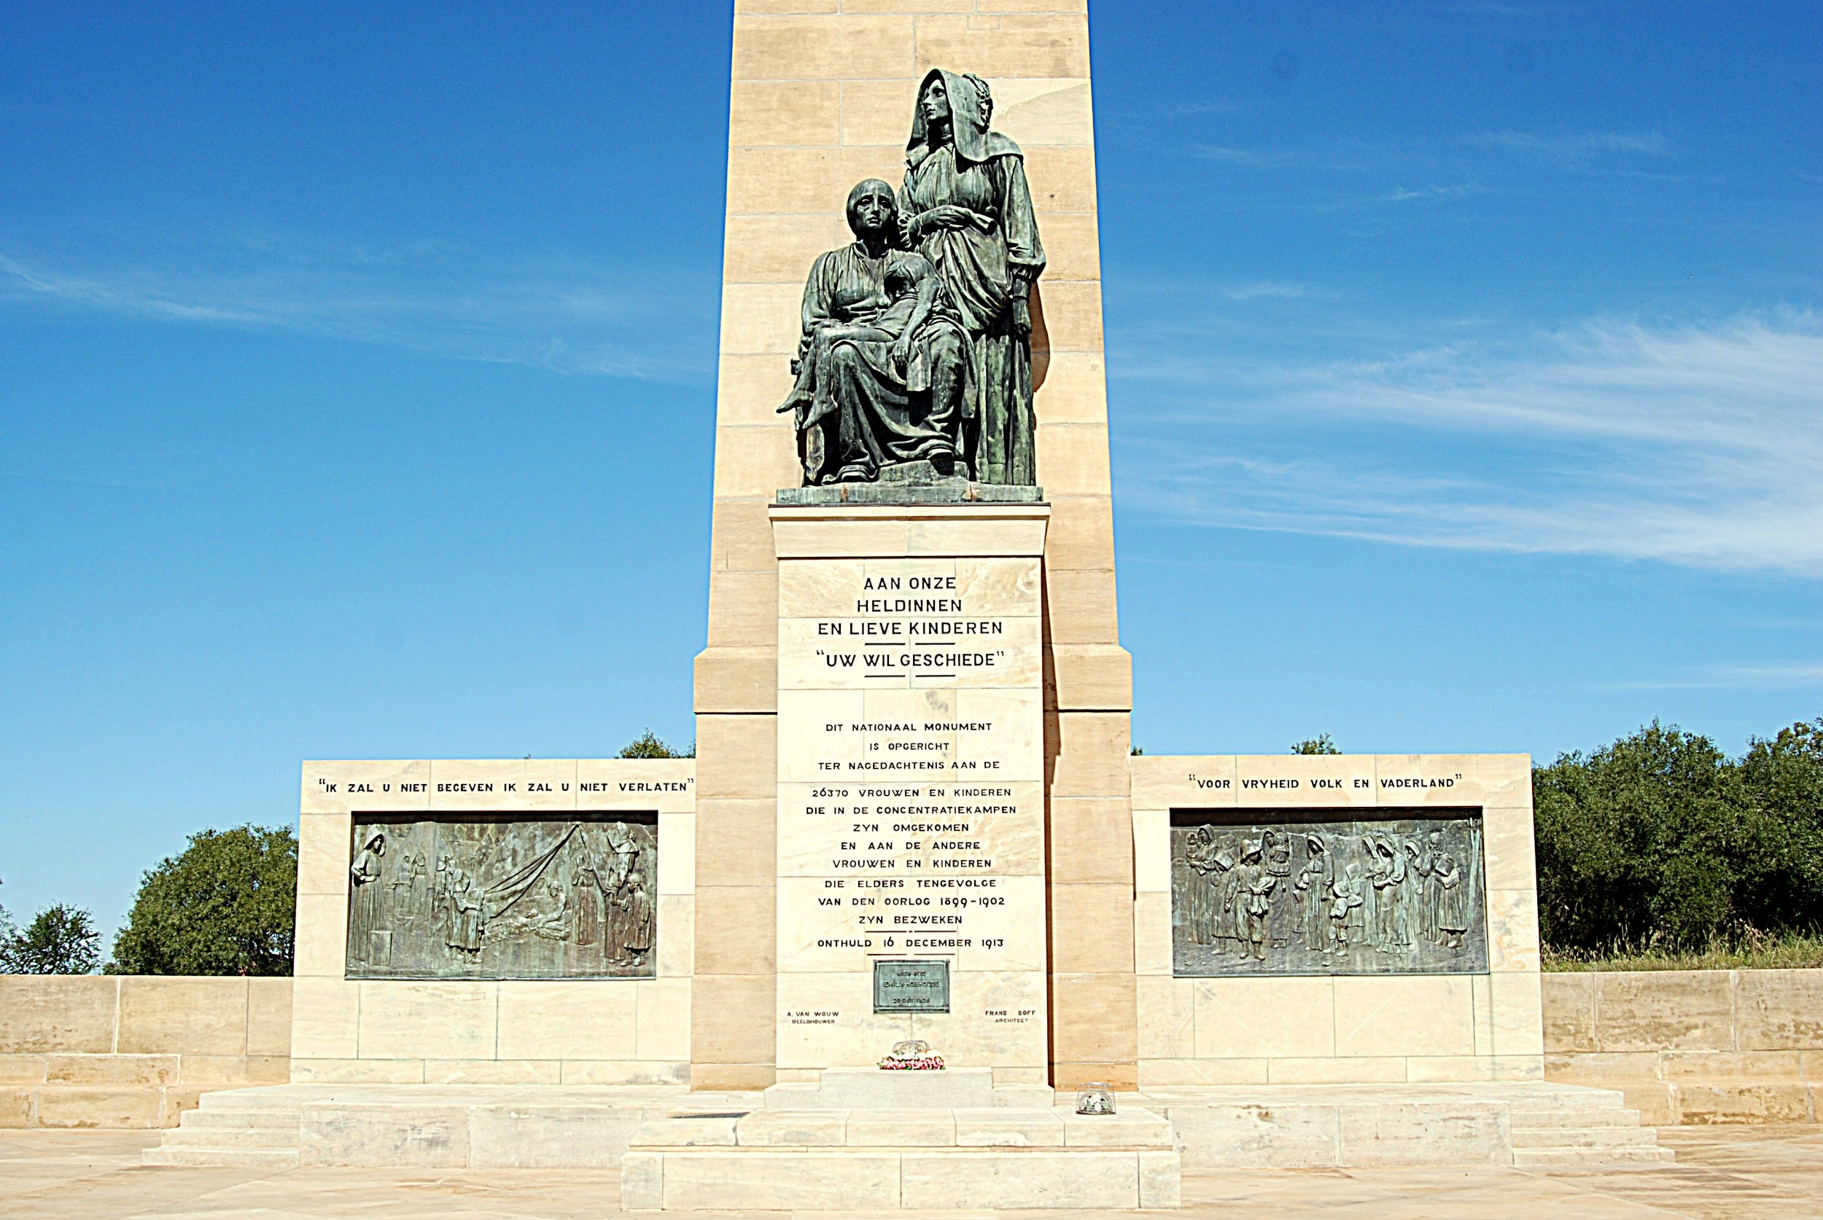
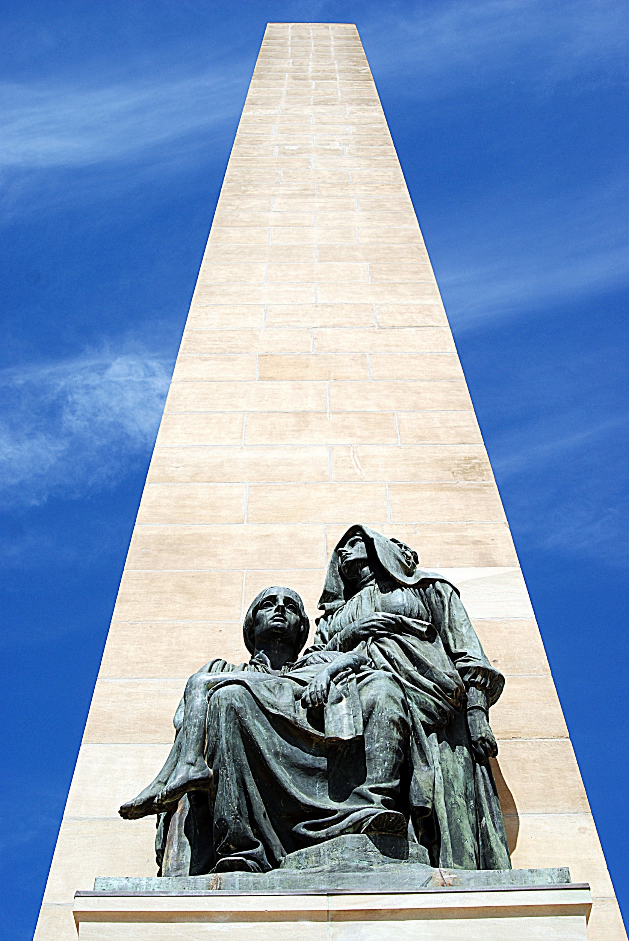
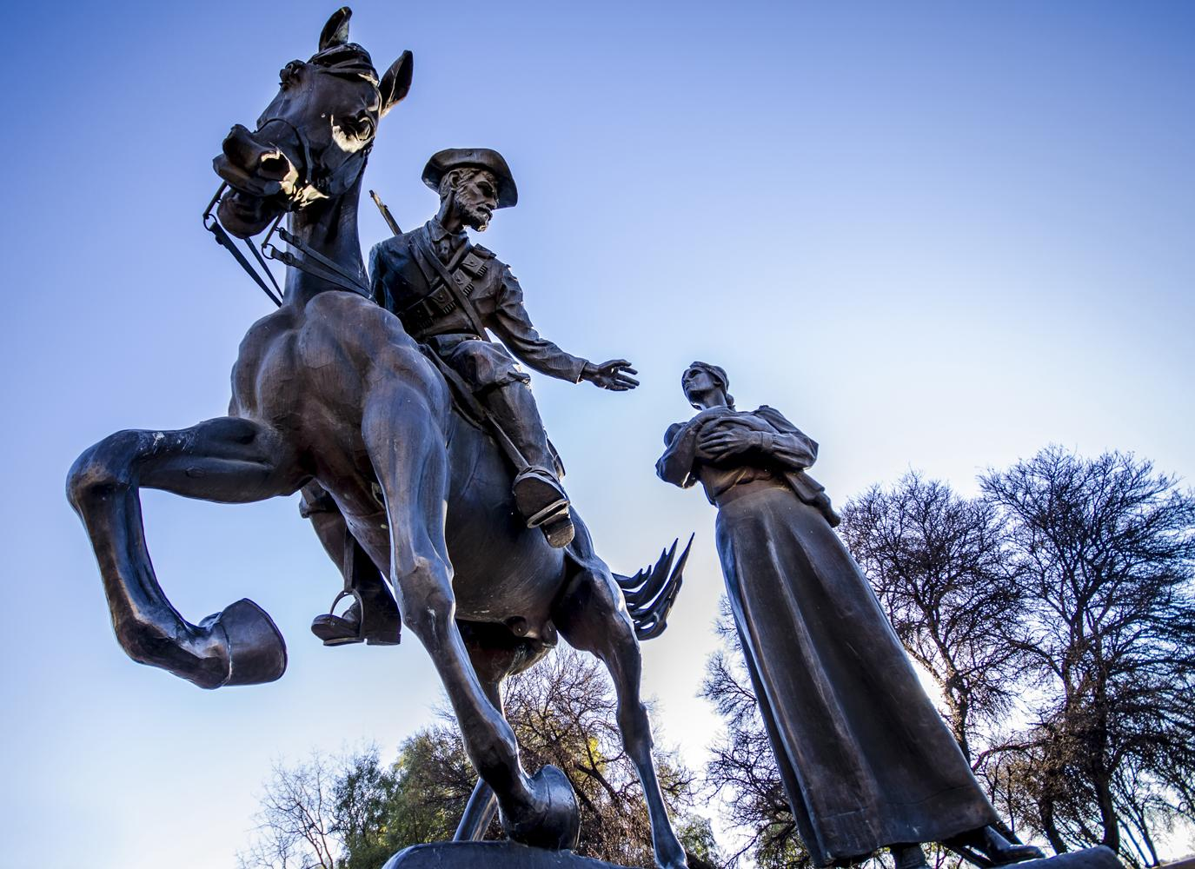
South Africa National Women’s Monument in Bloemfontein
© ICTJ 2018
Notes:
Photos (left to right): National Women’s Monument in Bloemfontein, South Africa (Wikimedia Commons/Hendrik van der Berg); close-up view of National Women’s Monument (Wikimedia Commons/Hendrik van der Berg); “Afskeid” statue at the entrance of the National Women’s Monument in South Africa (Wikimedia Commons/Carlviloria).

Slide 27
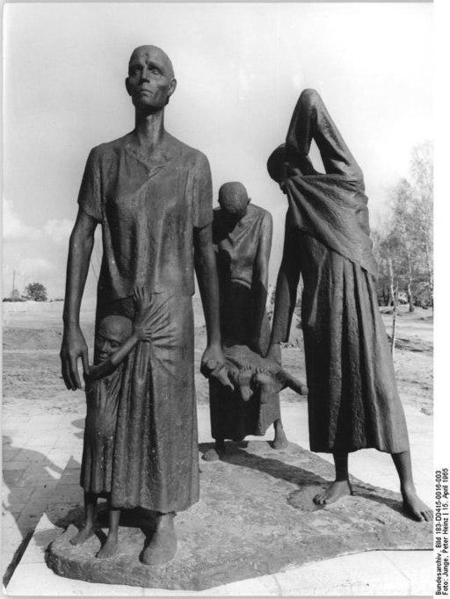
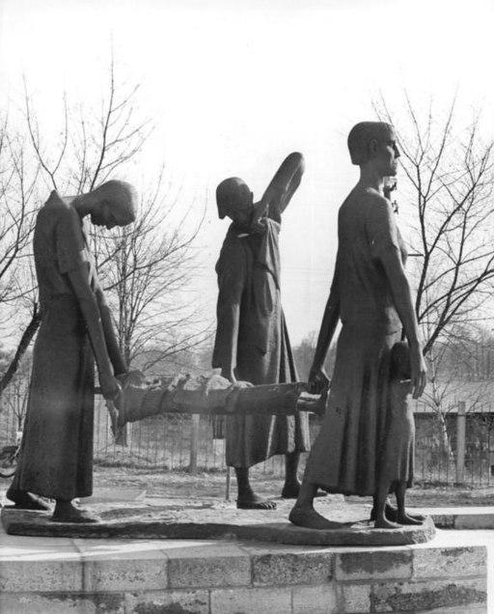
Mother’s Group (Muttergruppe)
© ICTJ 2018
Notes:
Photos: Mother’s Group statue on the road to the Ravensbruck Concentration Camp in Germany. (Bundesarchiv/Peter Heinz Junge)

Slide 28
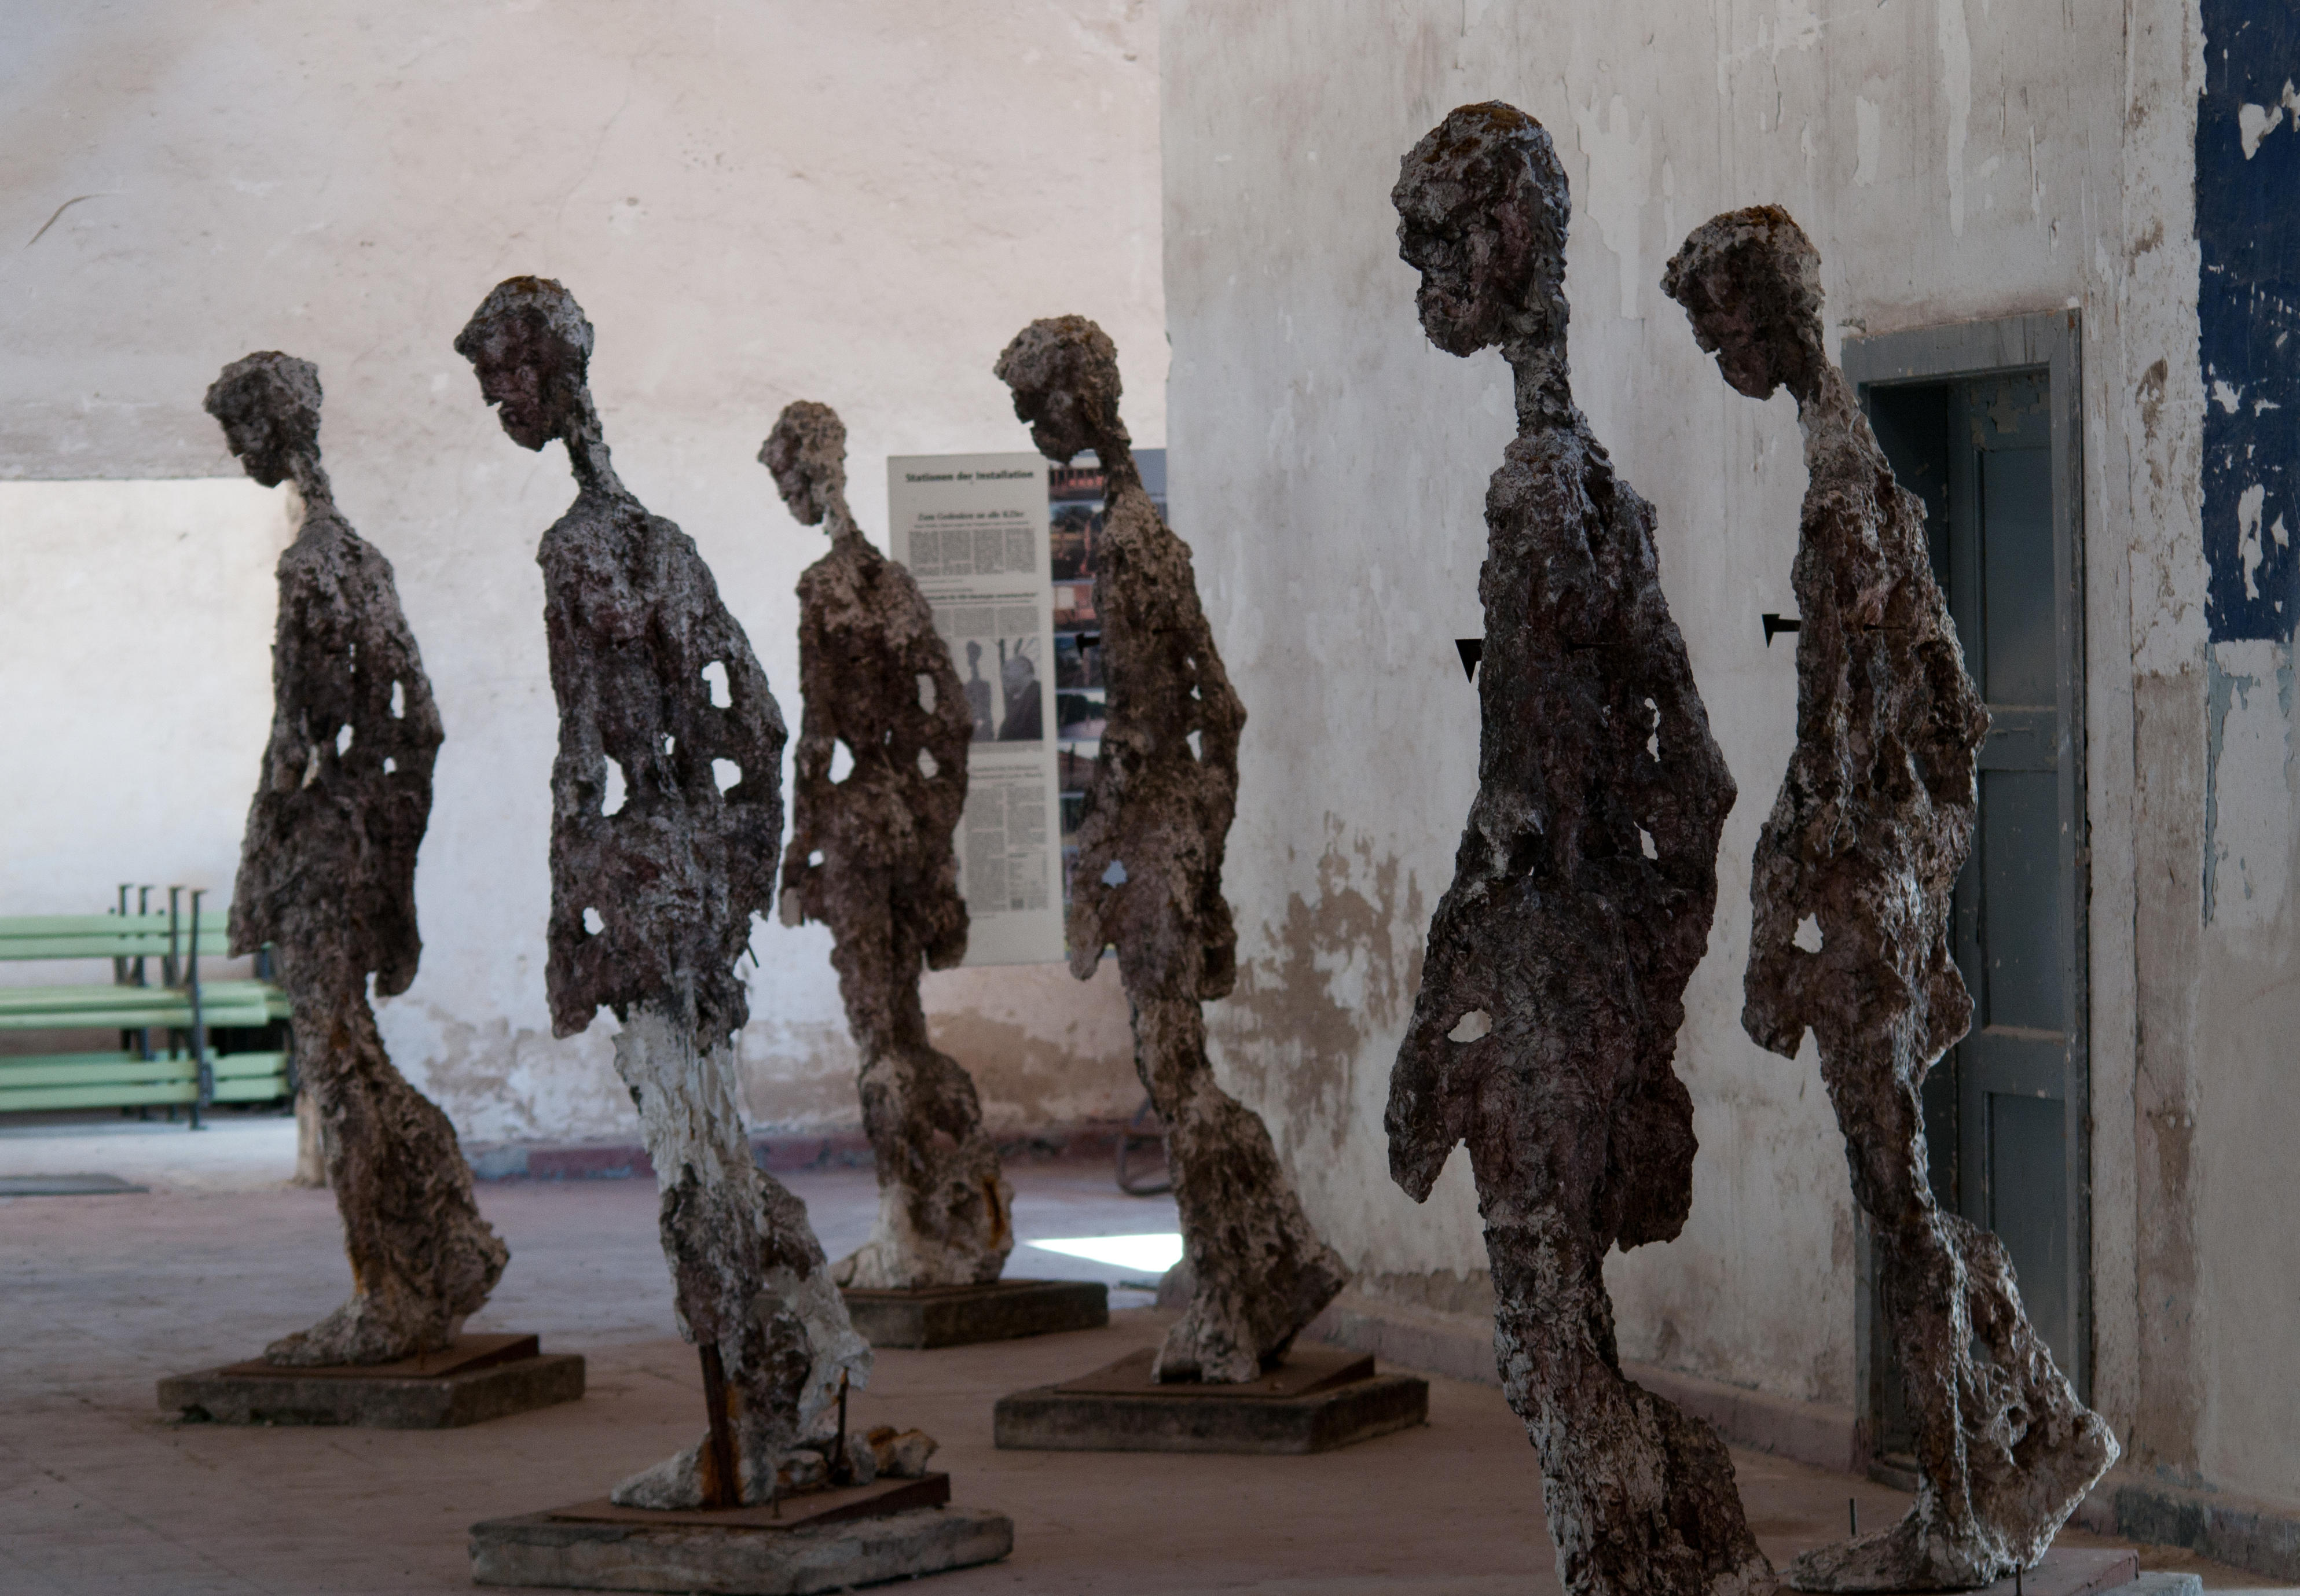
Figures Against Forgetting at Ravensbrück Women’s Camp
© ICTJ 2018
Notes:
Photo: A memorial to women victims who were interned at Ravensbrück Women’s Camp in Nazi Germany. (Germany Images David Crossland/Alamy Stock Photo)

Slide 29
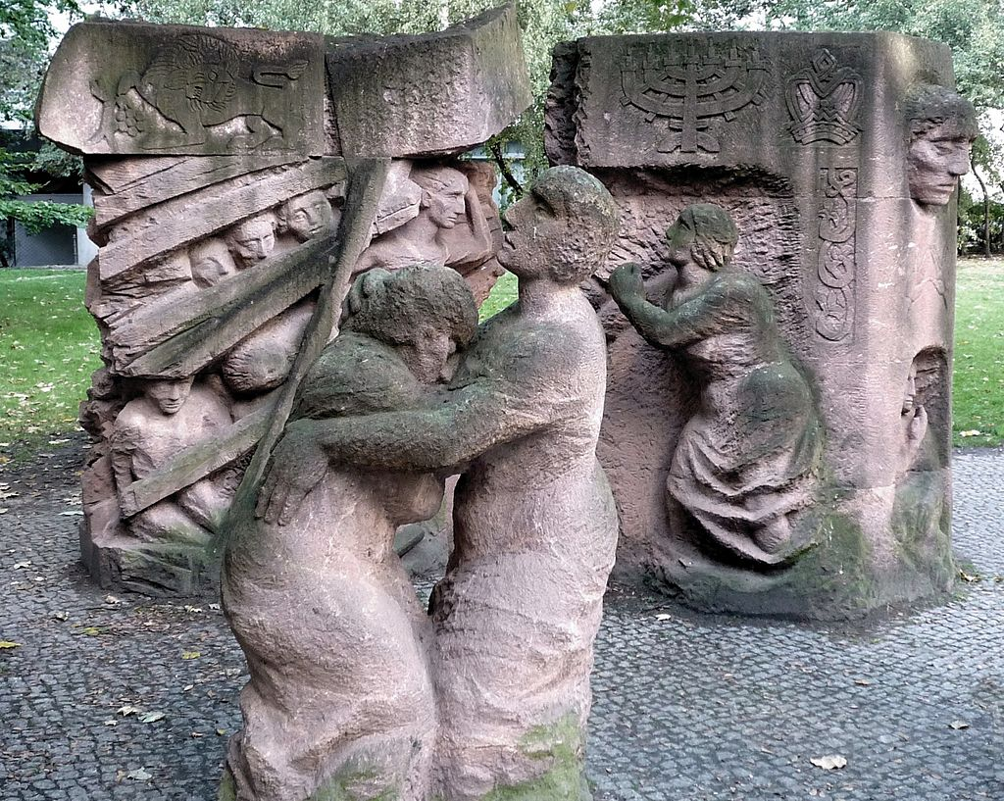
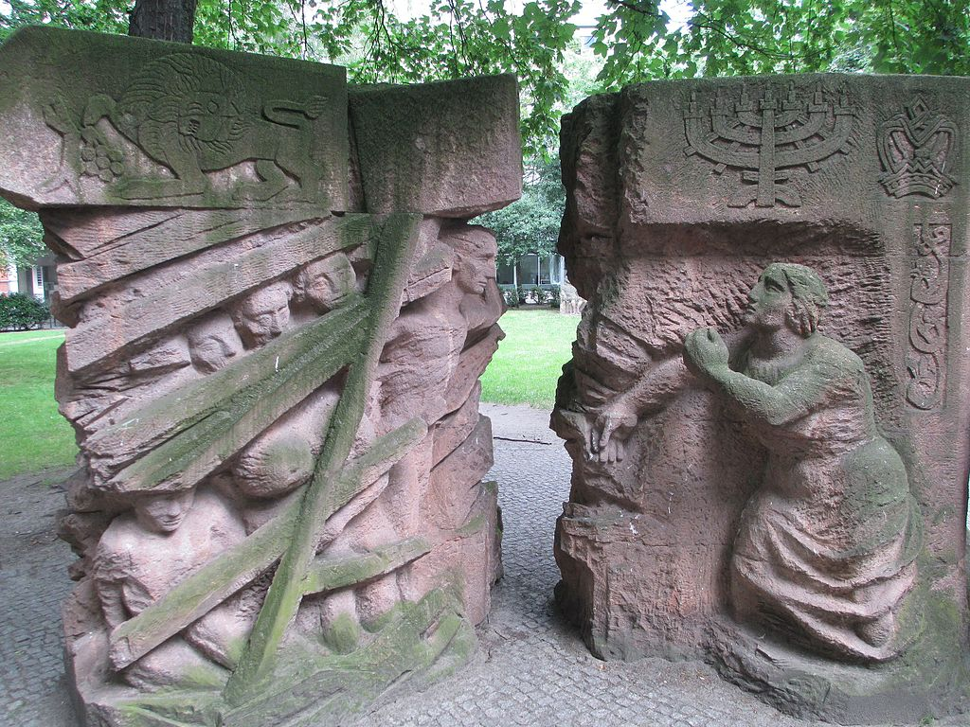
Rosenstrasse Monument
© ICTJ 2018
Notes:
Photos: Rosentrasse Monument in Berlin, Germany. (Left to right: Wikimedia Commons/Manfred Brückels, Wikimedia Commons/Avishai Teicher (Avi1111))

Slide 30
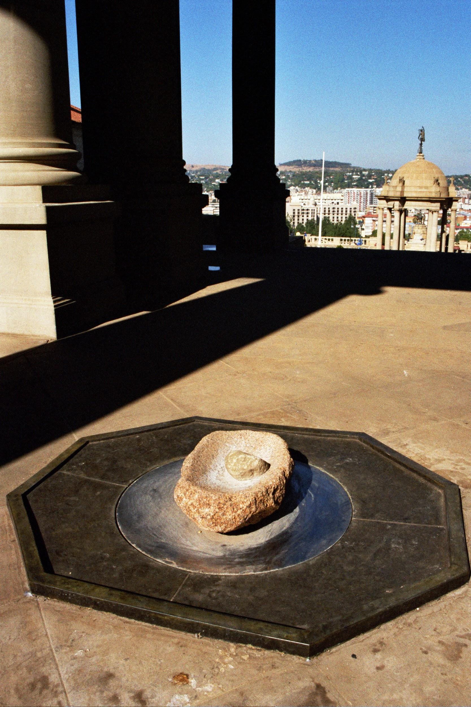
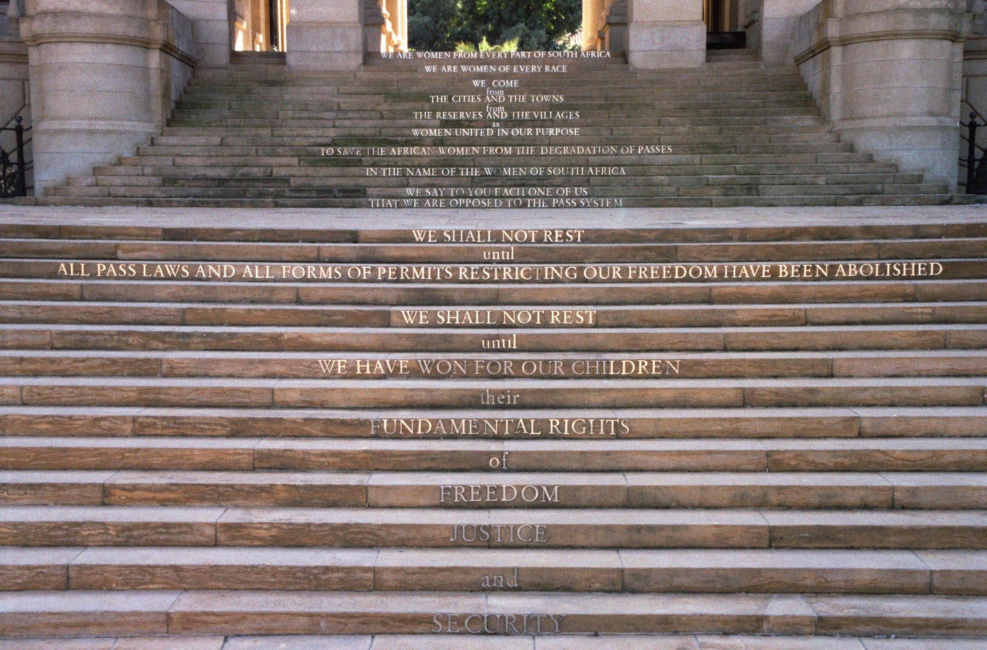
Strike the Woman, Strike the Rock
Notes:
Photo: Designed by Wilma Cruise, Strike the Woman, Strike the Rock memorializes the women who protested South Africa’s “pass laws.” (Adam J. Cruise)

Slide 31
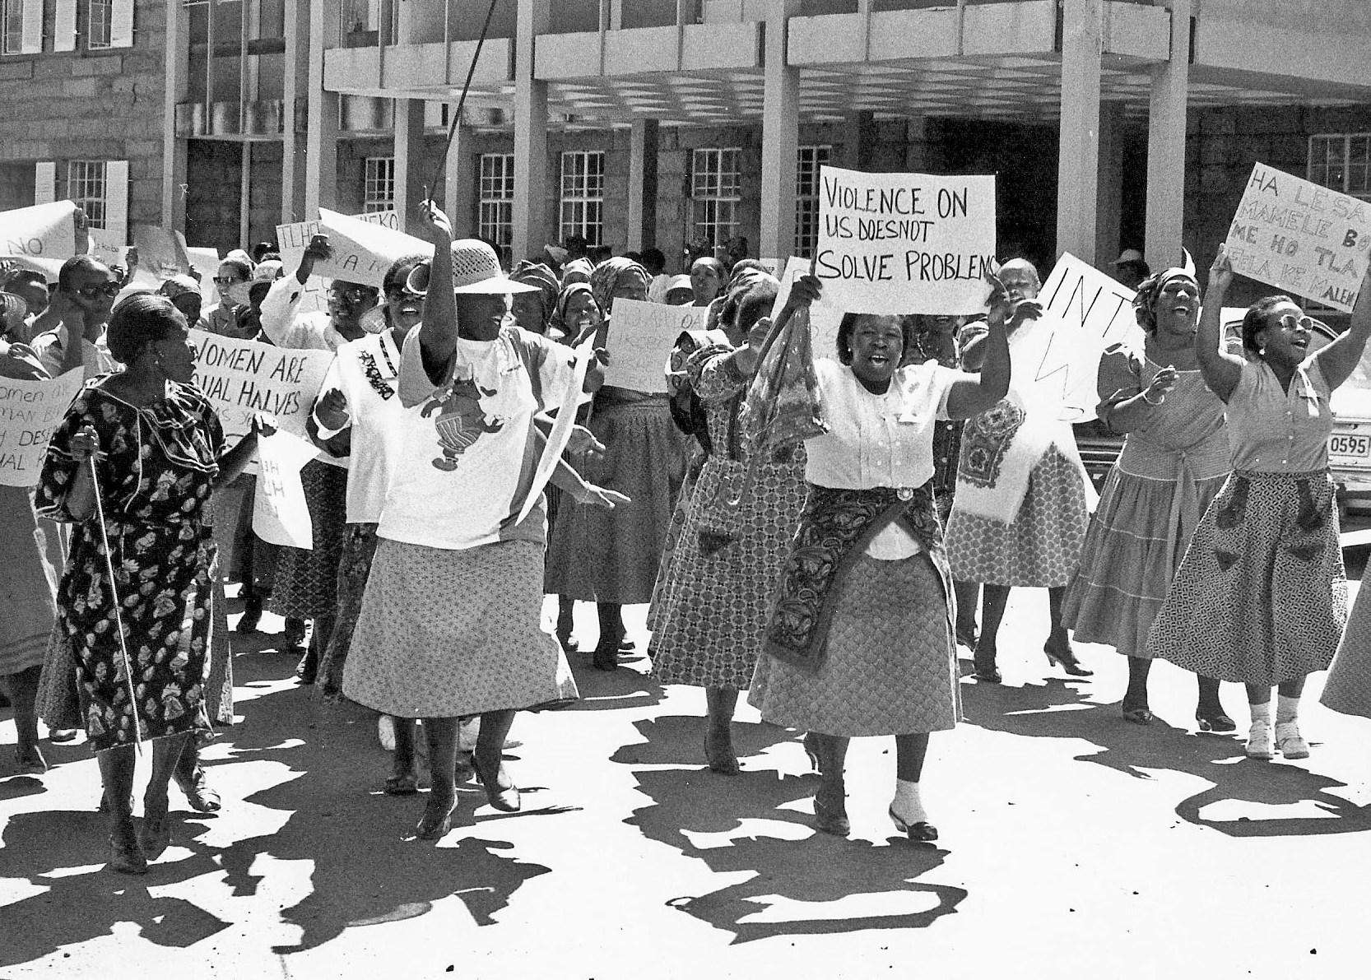
Remembering the 1956 Women’s March in South Africa
© ICTJ 2018
Notes:
Photo: Women march in 1956 against the “pass laws” that would require them to carry passes. (Flickr/K. Kendall)

Slide 32
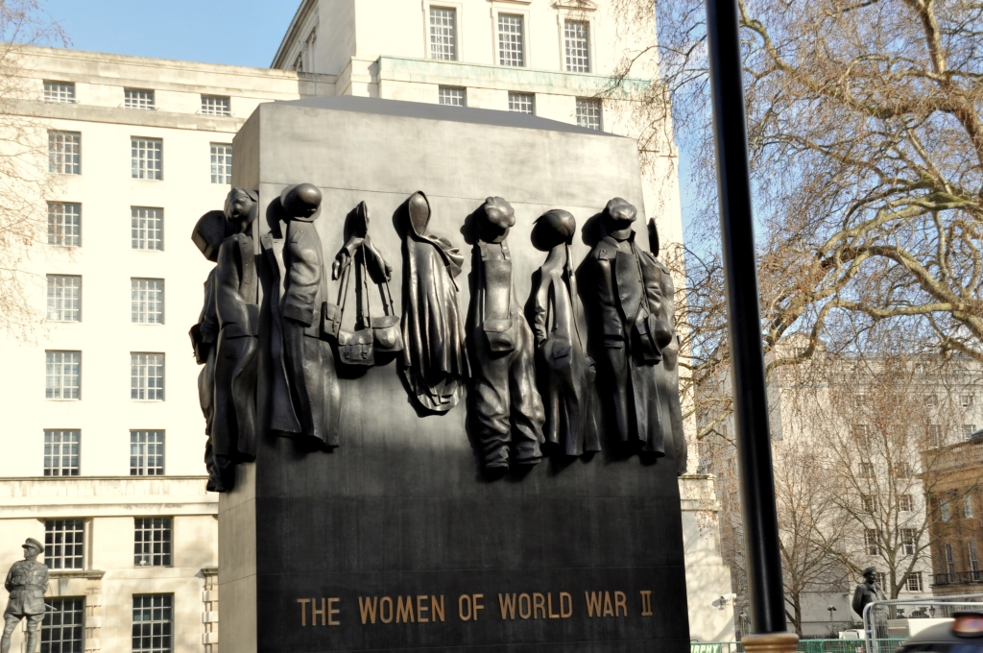
National Monument to the Women of World War II
© ICTJ 2018
Notes:
Photo: National Monument to the Women of World War II in the United Kingdom. (Wikimedia Commons/Eluveitie)

Slide 33
7. Memorials: Truth Seeking, Truth Telling, and Gender
Memorials are an integral part of truth seeking and truth telling; they are often recommended or informed by truth commissions.
Commission for Reception, Truth, and Reconciliation (CAVR) in Timor-Leste
Truth and Reconciliation Commission in Sierra Leone
National Commission on Truth and Reconciliation in Chile
However, memorials can be created in the absence of a truth commissions, often at the initiative of civil society and sometimes long after the end of conflict, repressive rule, or violence.
© ICTJ 2018

Slide 34
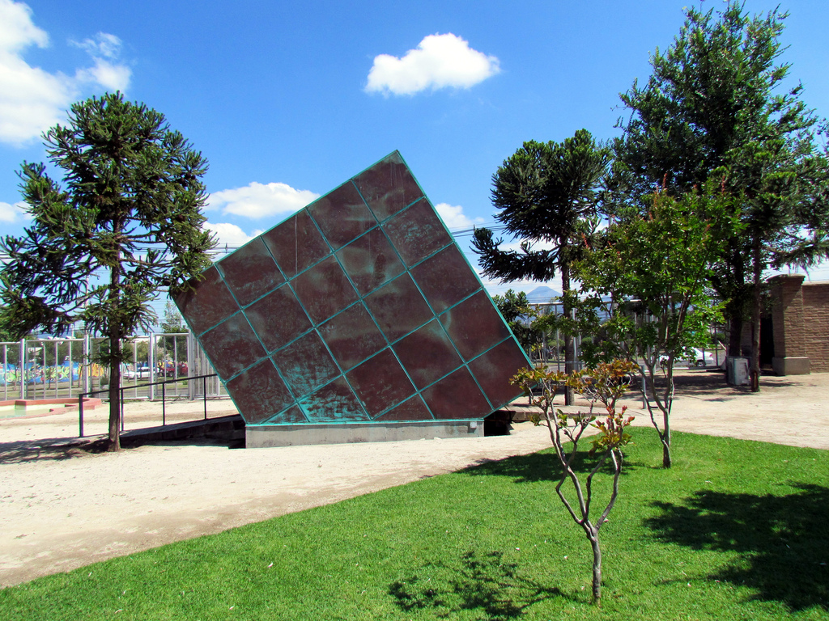
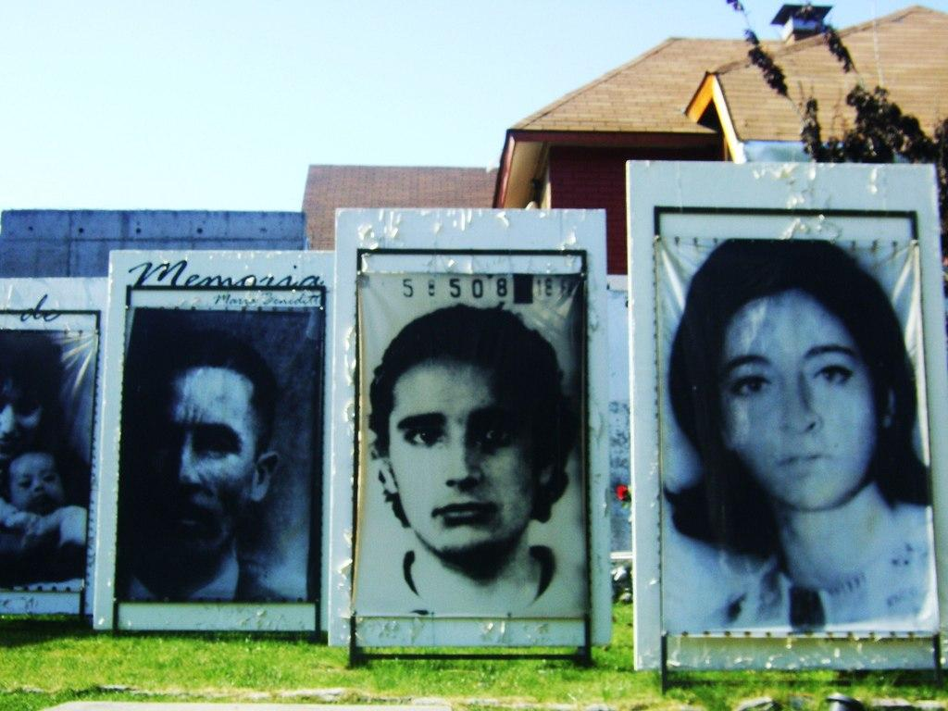
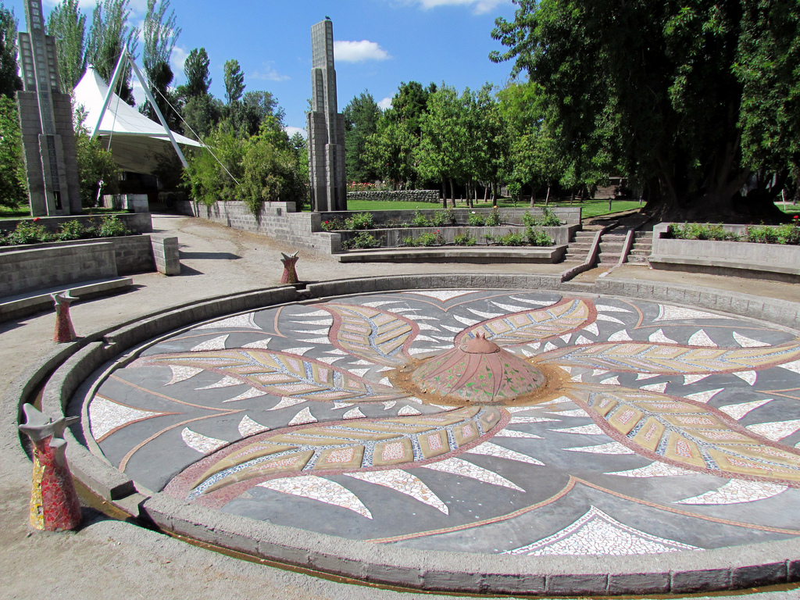
Chile: Commemorations as Symbolic Reparations
Park for Peace at Villa Grimaldi in Santiago, Chile
Notes:
Photo: Park for Peace (Parque por la paz) at Villa Grimaldi in Santiago, Chile. (Left to right: Razi Sol (Flickr/Marysol, Flickr/David Berkowitz, Flickr/David Berkowitz)

Slide 35
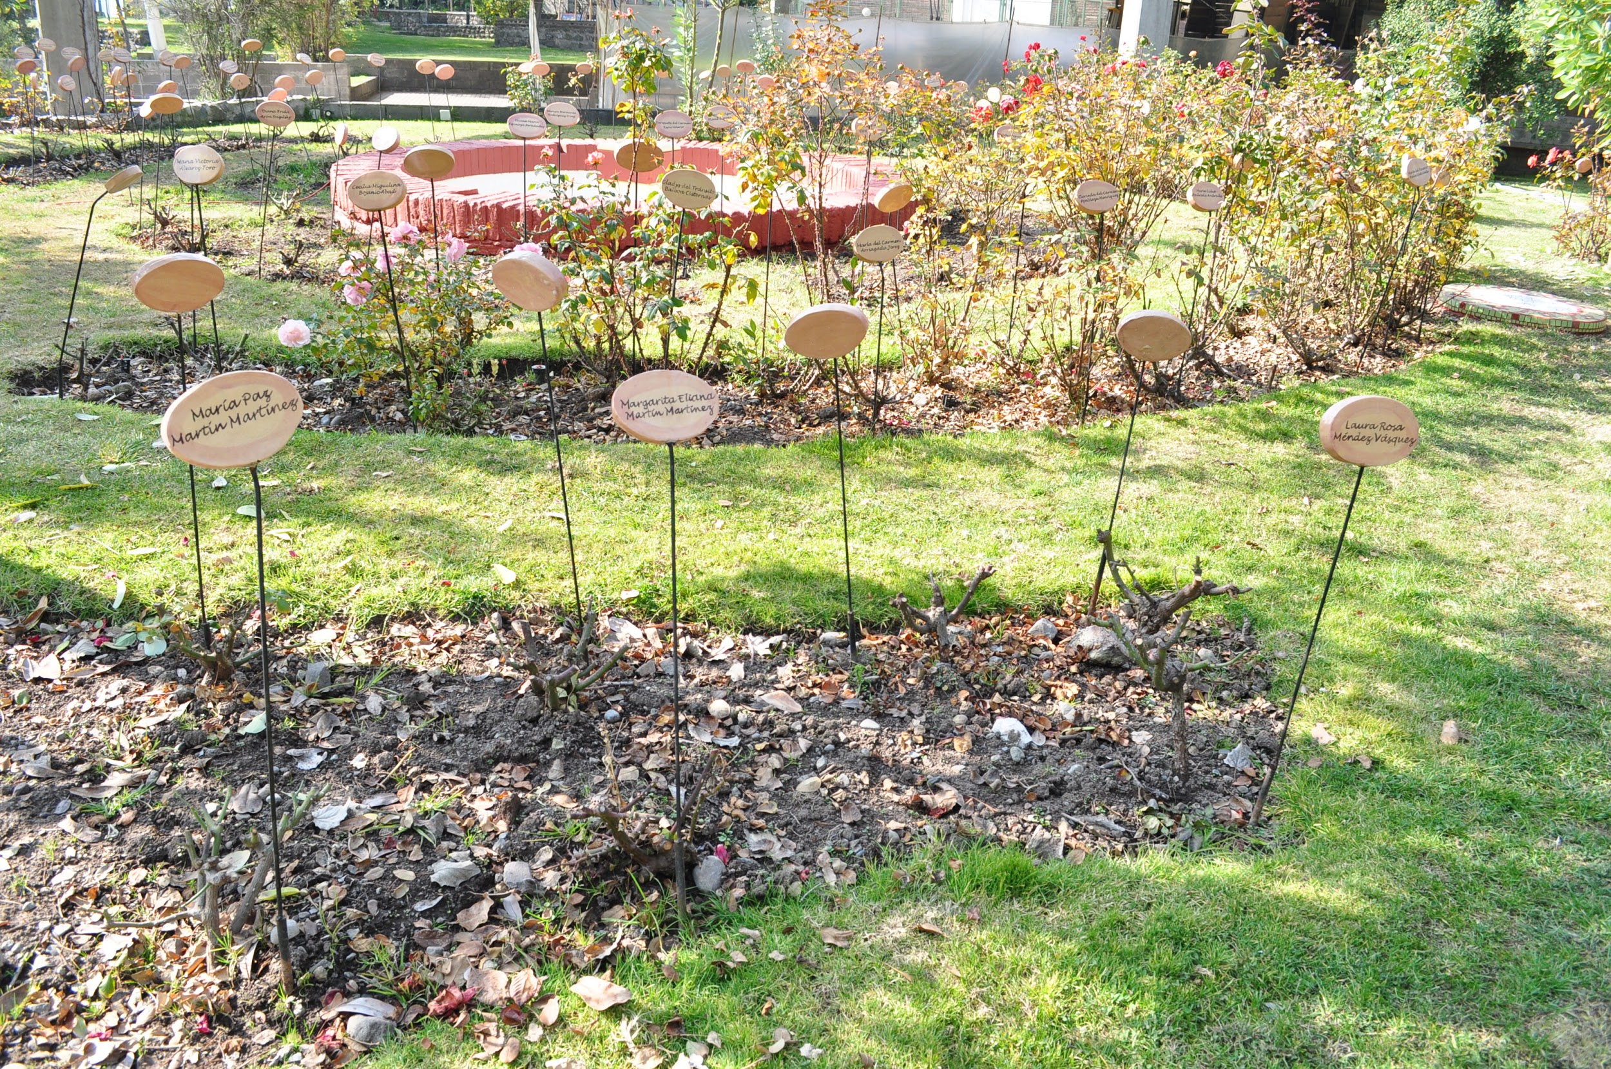
Chile: Commemorations as Symbolic Reparations
Rose Garden at Park for Peace at Villa Grimaldi commemorating women executed or disappeared
Notes:
Photo: Rose Garden within Park for Peace in Santiago, Chile (Wikimedia Commons/Arturo Rinaldi Villegas)

Slide 36
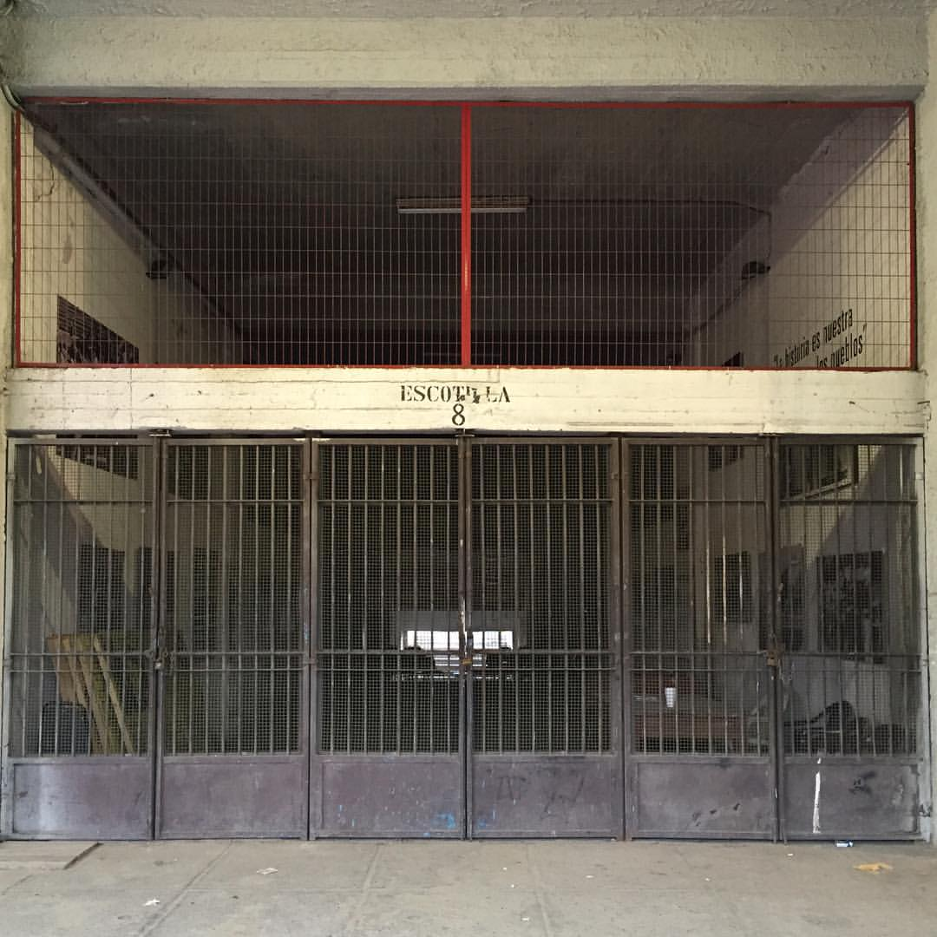
Escotilla 8 in Estadio Nacional Julio Martínez Prádanos
Notes:
Photo: Escotilla 8 in Chile’s national stadium commemorates the memory of thousands of Chilean prisoners who were detained and tortured here. (Flickr/Gonzalo Orellana Hidalgo)

Slide 37
8. Memorials as a Form of Symbolic Reparation
Memorials provide an opportunity to call attention to the injustices that occurred and acknowledge that victims suffered as a result.
Both a symbolic and collective form of reparation.
Memorials signify “state responsibility for harms as well as a public commitment to respond to their enduring impact.”
© ICTJ 2018

Slide 38
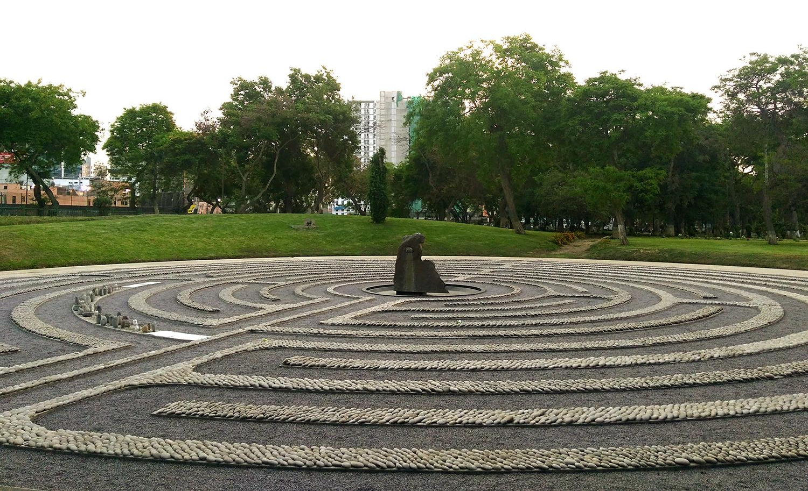
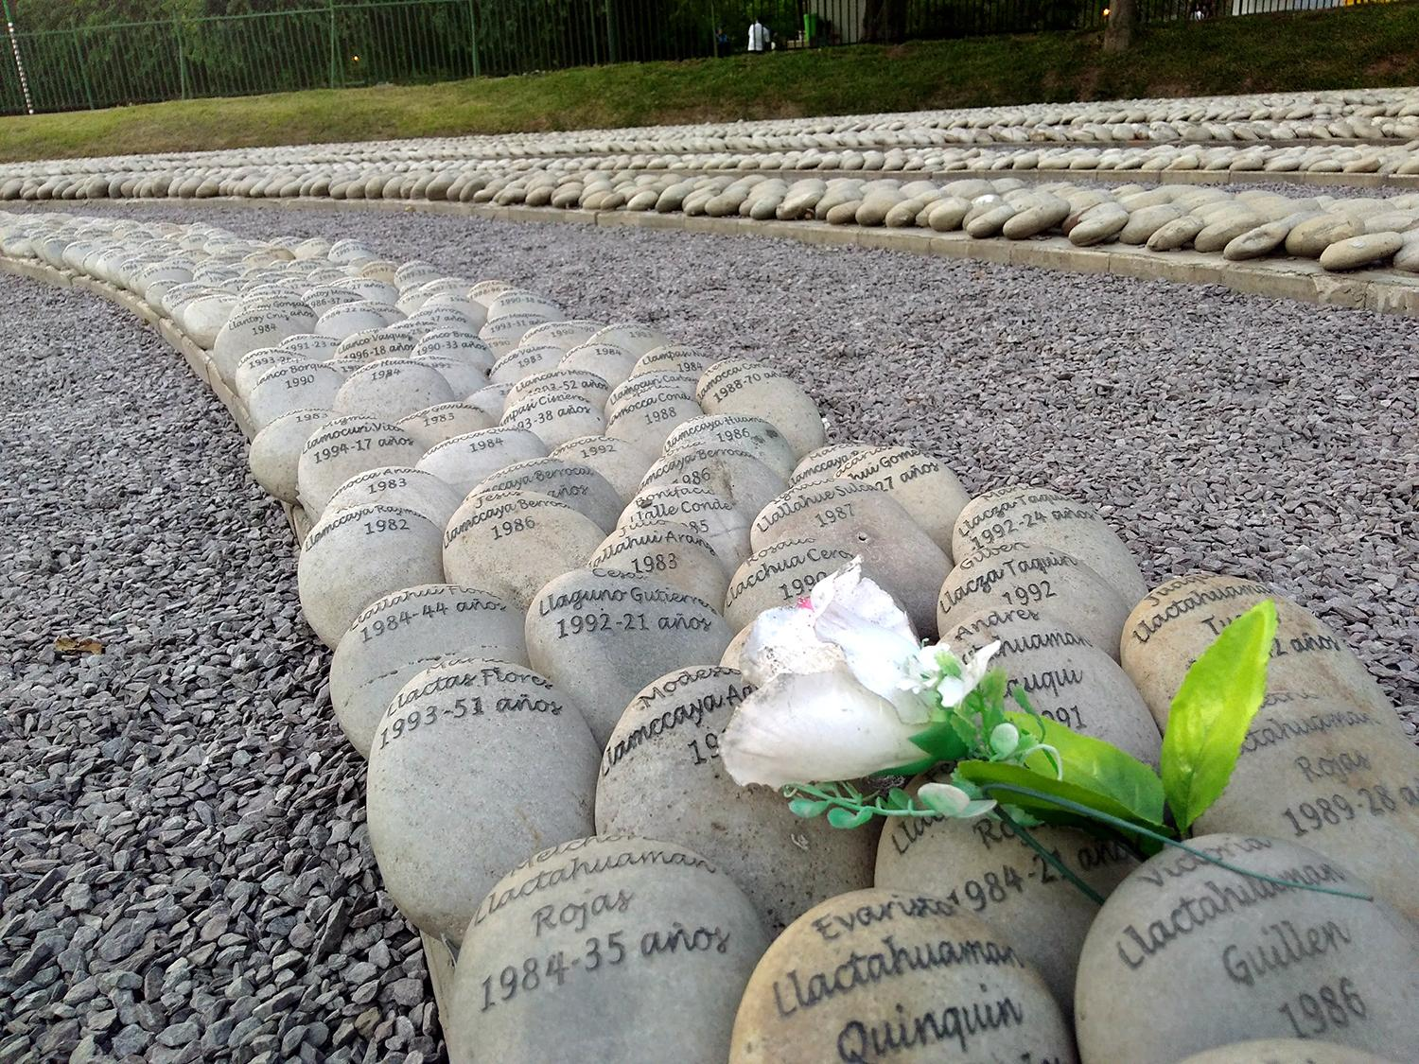
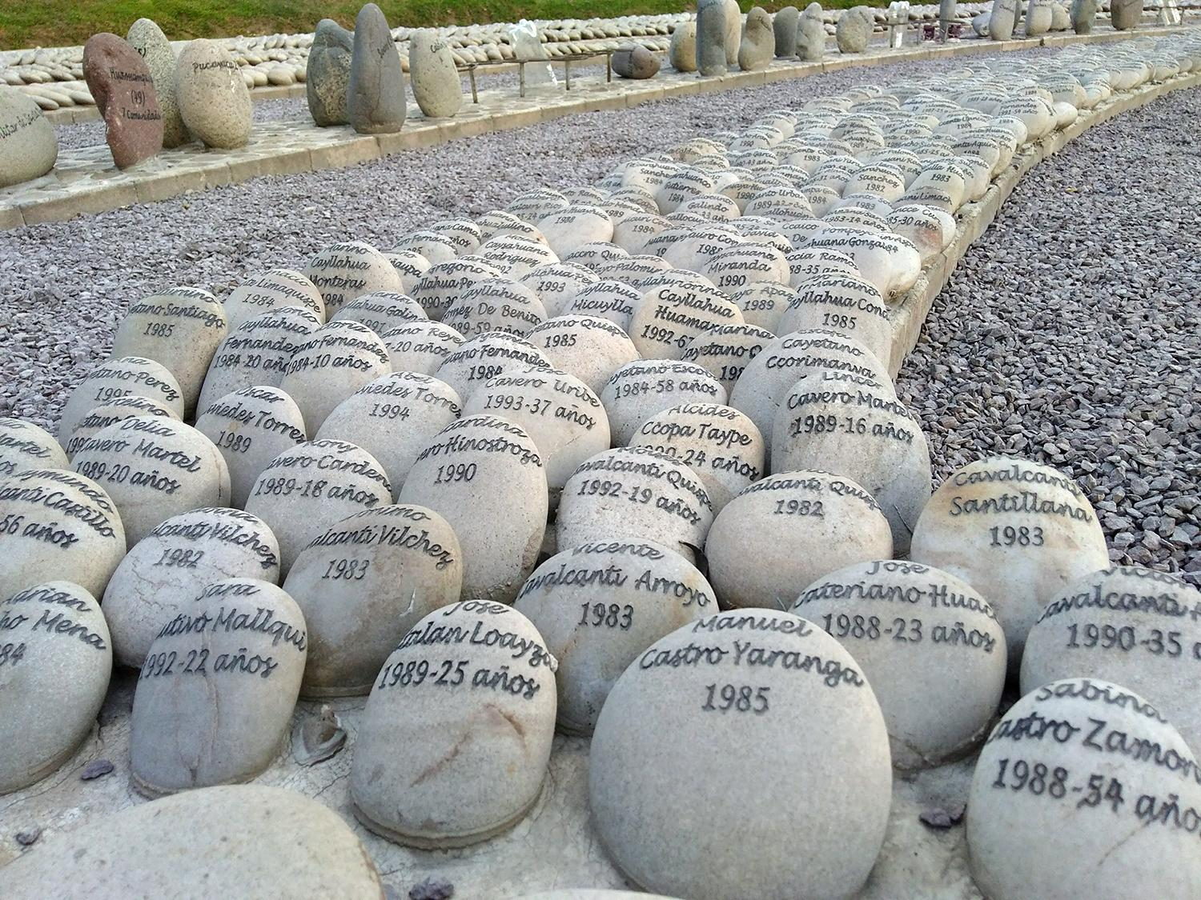
The Eye That Cries (El Ojo que Llora)
Notes:
Photos: The Eye That Cries (El ojo que llora) commemorates victims of Peru’s internal armed conflict, the water representing the tears of Mother Earth on behalf of her children (Lapalabranecesaria/Wikimedia Commons)

Slide 39
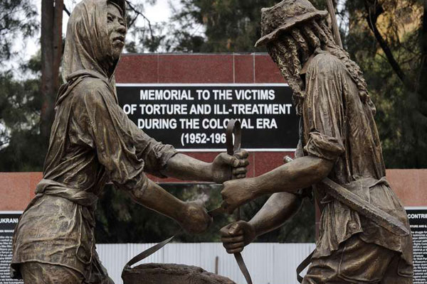
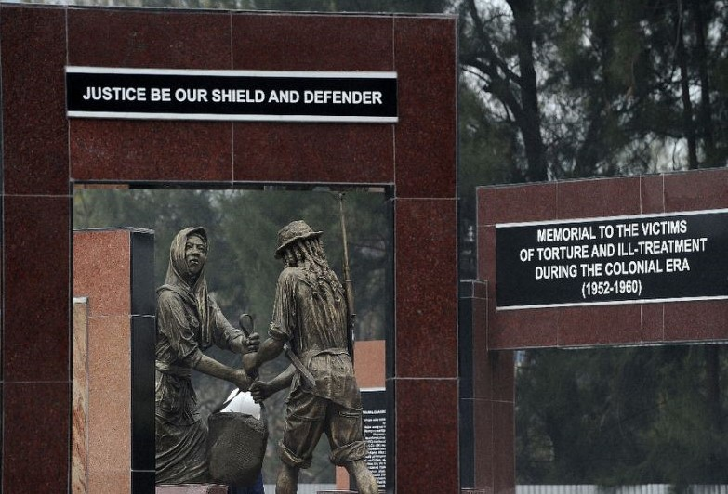
Mau Mau Monument
© ICTJ 2018
Notes:
Photos: In Nairobi, Kenya, the Mau Mau Monument was built from an unprecedented settlement by a foreign government (U249601/Wikimedia Commons)

Slide 40
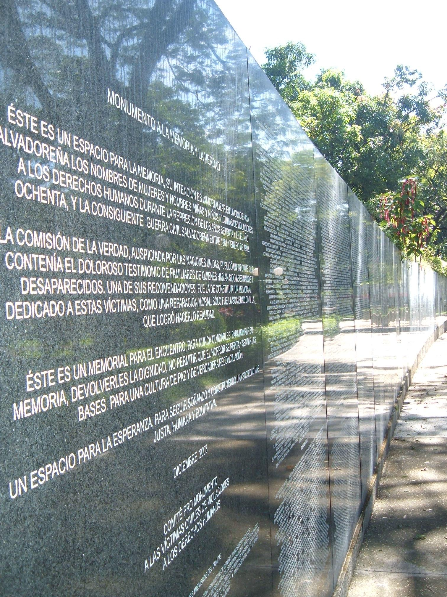
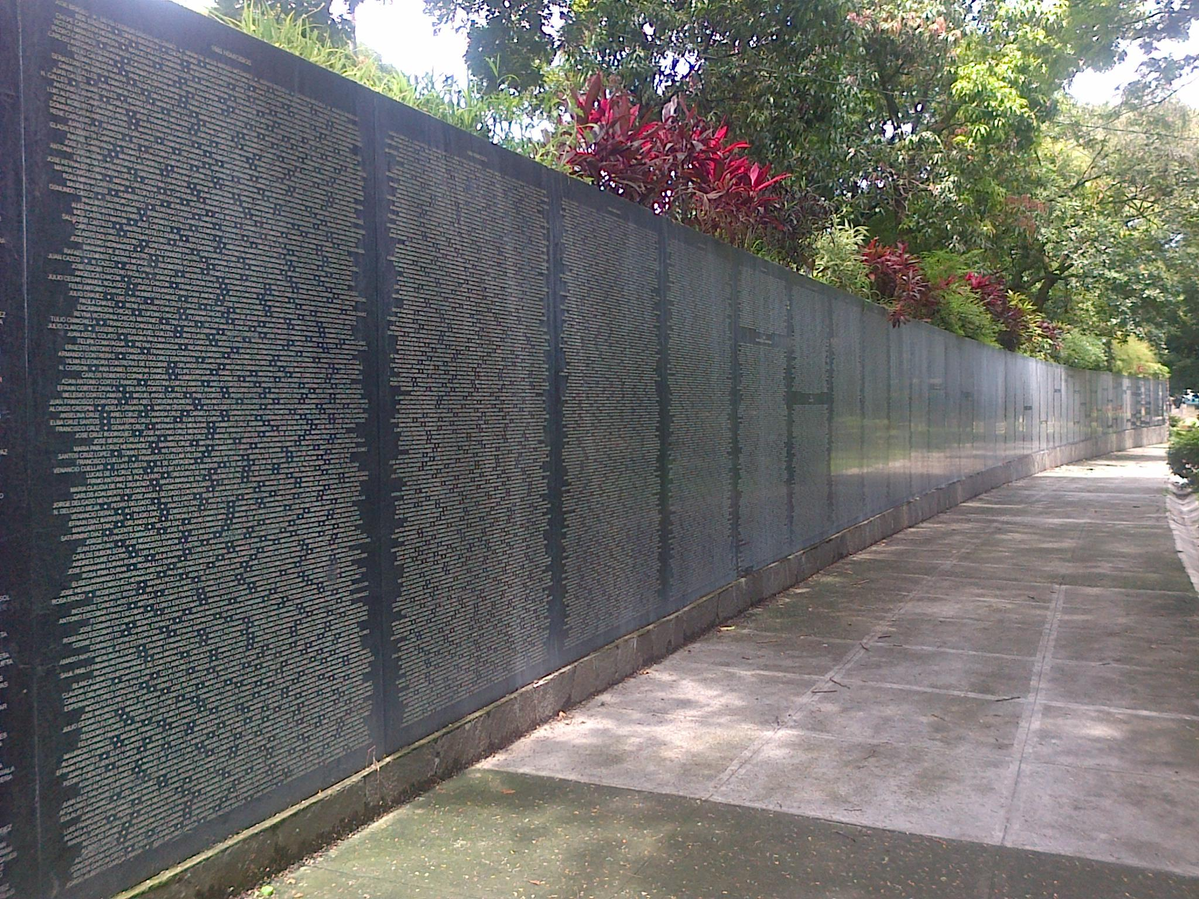
Monument to Truth and Memory (Monumento a la memoria y la verdad)
Notes:
Photos: The Monument to Truth and Memory in El Salvador was mandated by the country’s Truth and Reconciliation Commission (left to right: Wikimedia Commons/AnaLi197; Wikimedia Commons/Jorge Montenegro)

Slide 41
9. Challenges for Successful, Representative Memorialization Processes
Broad community participation and consultation - with the full participation of women, girls, and others who may otherwise be marginalized - can help mitigate the potential for controversy and politicization and ensure adequate representation.
Consultations can help designers:
obtain basic demographic information;
identify and locate groups of victims;
understand immediate, medium, and long-term consequences;
understand the needs and priorities of a diverse set of victims, including women and girls.
© ICTJ 2018

Slide 42
The public acknowledgment that memorials provide can contribute to the healing process and help alleviate the trauma suffered by victims and victim communities.
Yet it is also important to remember that in the absence of other forms of truth, justice, and redress, many victims may rightfully reject memorials no matter the process of consultation and participation.
© ICTJ 2018

Slide 43
Other Important Factors to Consider
Managing expectations and anticipating some disagreement
Promoting healing and heconciliation and avoiding harm, exploitation, or retraumatization
Resources to build and maintain memorials
© ICTJ 2018

Slide 44
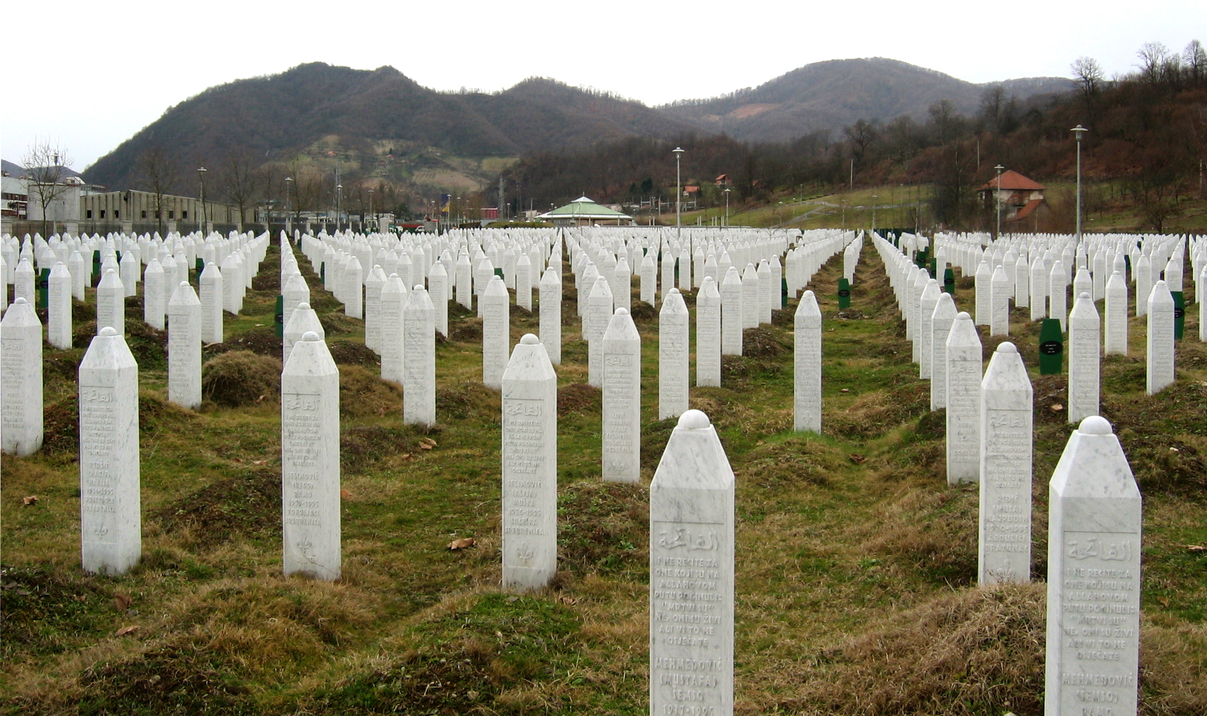
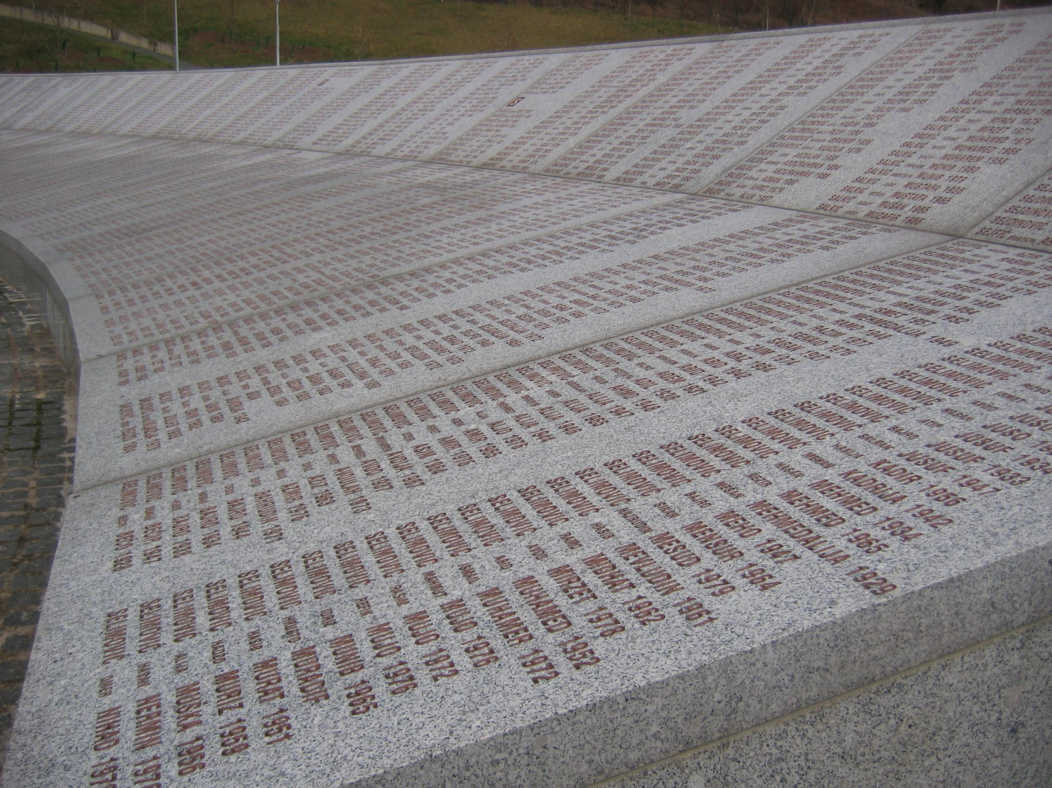
Srebrenica
© ICTJ 2018
Notes:
Photo: The Srebrenica-Potocari Memorial Center and Cemetery in Bosnia-Herzegovina, Srebrenica (Both photos by Wikimedia Commons/Michael Büker)

Slide 45
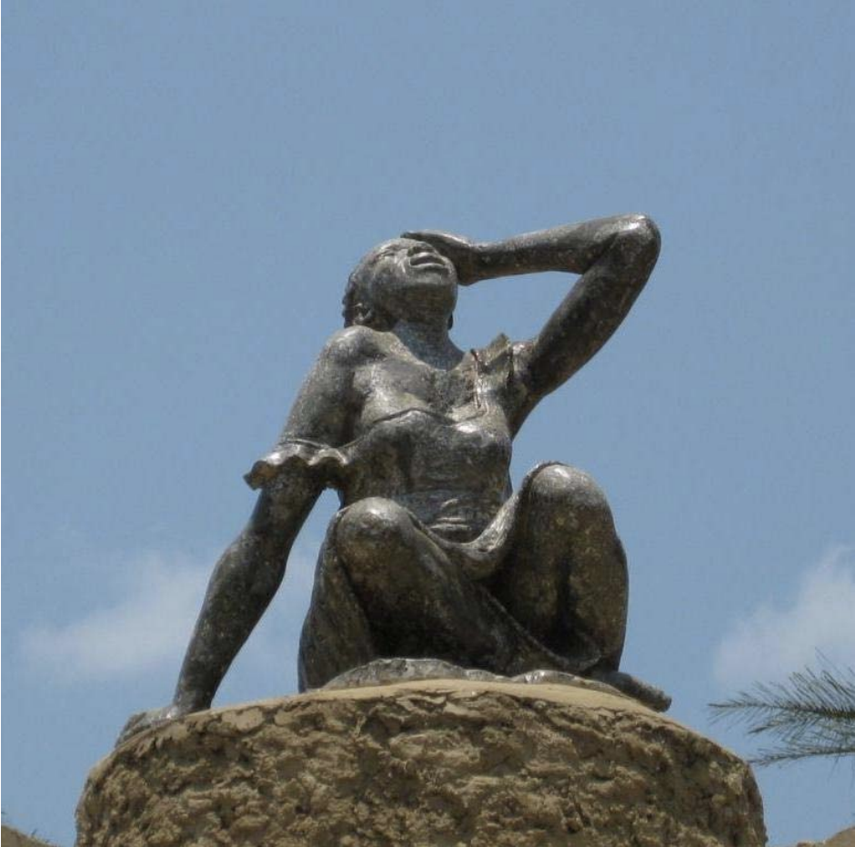
Statue to Women Victims of War in South Kivu
© ICTJ 2018
Notes:
Photo: Statue dedicated to women victims in Shabunda, South Kivu, DRC. (OHCHR)

Slide 46
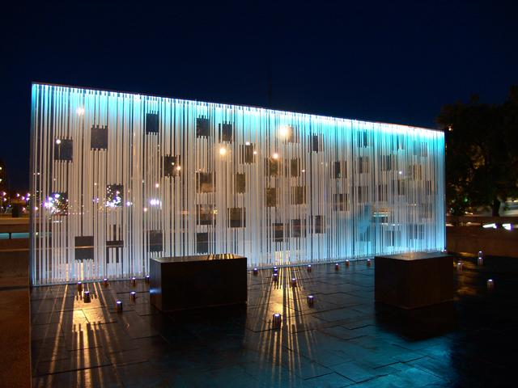
Women in Memory Monument
© ICTJ 2018
Notes:
Photo: The Women in Memory Monument in Santiago, Chile (Wikimedia Commons/Museo de la Memoria y los Derechos Humanos)

Slide 47
10. What Can Be Done to Make Memorials Relevant to and Meaningful for Women and Girl Victims?
If memorials are to be meaningful for women and girls, effort must be made at every opportunity to ensure they reflect the full range of their experiences during periods of violence, repression, and transition.
That means gender must be considered at every step of the process.
© ICTJ 2018

Slide 48
Avoiding the Marginalization of Women and Girls
How did women and their experiences fit into the time of conflict or repression?
How were women harmed?
Are there differences between and among categories of women in the types of harm suffered and violations committed?
Do women have different needs, priorities, and expectations for the memorialization project?
How will the memorial reflect the experiences of the victims?
Design is paramount. Some mediums are likely to favor male victims or honor only the most powerful or privileged members of society. Are design choices privileging men and their experiences or stereotyping women or their roles in the transition?
Does the project perpetuate dominant gender norms or reinforce current power structures in the home, community, or country?
Is the recommended approach or medium likely to disadvantage women? For instance, will a museum on the site of a former detention center used for men prisoners only dignify male victims and the harms they suffered?
Will the memorial blur over important distinctions between men and women or perpetuate stereotypes?
Will commemorative activities exclude women? Who will lead the event or events and how?
Are individual or collective approaches preferable? How will they affect women victims?

